Slide 1

Modelling
23AID201
Lecture 2
Dr. Mrittunjoy Guha Majumdar
School of Artificial Intelligence, Amrita Vishwavidyapeetham Delhi NCR

Slide 2
What is Modelling?
As a basic principle we may say that a model is a simplified version of something that is real.
The traits of the model can vary according to its use. They can vary in their
  Level of formality
  Explicitness
  Richness in detail
  Relevance
The characteristics depend on the basic function of the model and the modeling goal.
Models can have many different functions:
Explain Phenomena – Models formalize system behavior (for instance, Newton’s laws for mechanics, IS/LM in economics, predator–prey in biology).
Make Predictions – Models forecast outcomes (for instance, avalanche probability from snow data, climate change from greenhouse gas emissions, airplane maneuverability from aerodynamic models).
Decision Making – Models optimize actions under constraints (for instance, chemical plant design equations, traffic models for route choice, supply chain optimization).
Communication – Models convey structured knowledge (for instance, a route sketch to a visitor, circuit diagrams in engineering, UML diagrams in software design).
Others – Models serve as normative frameworks (for instance, aircraft maintenance checklists, ANSI/DIN/EU standards regulating industrial and public systems).

Slide 3
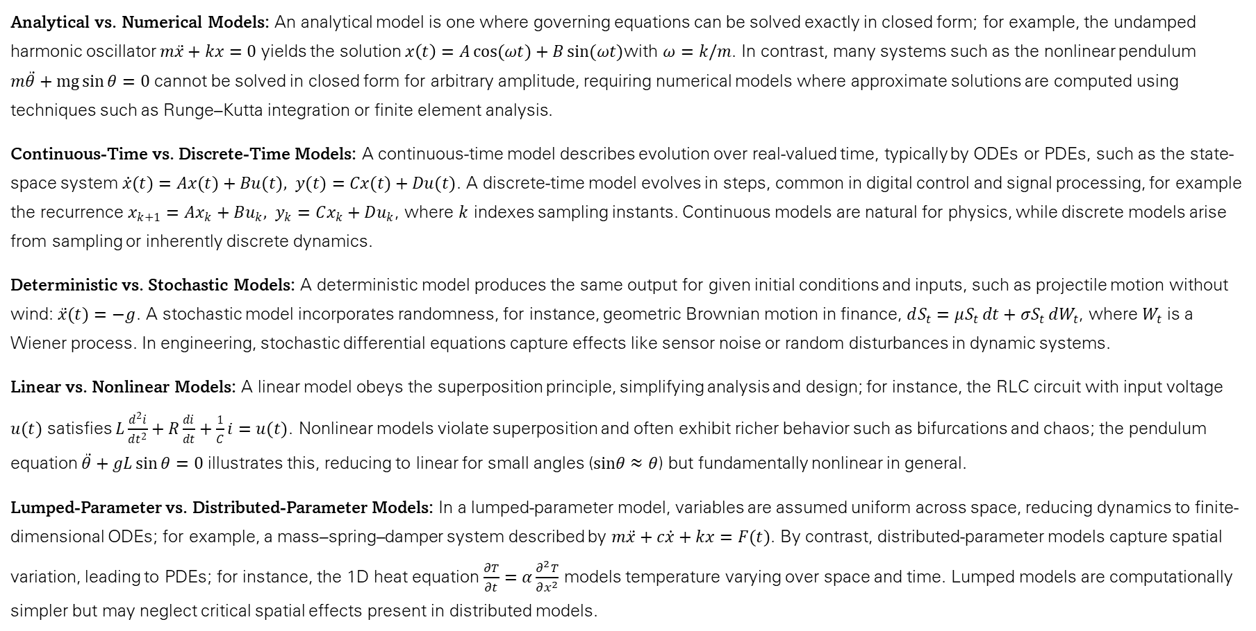
Types of Models
Analytical vs. Numerical Models: An analytical model is one where governing equations can be solved exactly in closed form; for example, the undamped harmonic oscillator $m\ddot{x}+kx=0$ yields the solution $x\left(t\right)=A\cos{(ωt)}+B\sin{(ωt)}$with $ω=k/m$​. In contrast, many systems such as the nonlinear pendulum $m\ddot{θ}+mg\sin{θ}=0$ cannot be solved in closed form for arbitrary amplitude, requiring numerical models where approximate solutions are computed using techniques such as Runge–Kutta integration or finite element analysis.
Continuous-Time vs. Discrete-Time Models: A continuous-time model describes evolution over real-valued time, typically by ODEs or PDEs, such as the state-space system $\dot{x}(t)=Ax(t)+Bu(t), y(t)=Cx(t)+Du(t)$. A discrete-time model evolves in steps, common in digital control and signal processing, for example the recurrence $x_{k+1}=Ax_{k}+Bu_{k}, y_{k}=Cx_{k}+Du_{k}​$, where $k$ indexes sampling instants. Continuous models are natural for physics, while discrete models arise from sampling or inherently discrete dynamics.
Deterministic vs. Stochastic Models: A deterministic model produces the same output for given initial conditions and inputs, such as projectile motion without wind: $\ddot{x}(t)=−g$. A stochastic model incorporates randomness, for instance, geometric Brownian motion in finance, $dS_{t}=μS_{t} dt+σS_{t} dW_{t}$, where $W_{t}$​ is a Wiener process. In engineering, stochastic differential equations capture effects like sensor noise or random disturbances in dynamic systems.
Linear vs. Nonlinear Models: A linear model obeys the superposition principle, simplifying analysis and design; for instance, the RLC circuit with input voltage $u(t)$ satisfies $L\frac{d^{2}i}{dt^{2}}+R\frac{di}{dt}+\frac{1}{C}i=u(t)$. Nonlinear models violate superposition and often exhibit richer behavior such as bifurcations and chaos; the pendulum equation $\ddot{θ}+gL\sin{θ}=0$ illustrates this, reducing to linear for small angles ($sinθ≈θ$) but fundamentally nonlinear in general.
Lumped-Parameter vs. Distributed-Parameter Models: In a lumped-parameter model, variables are assumed uniform across space, reducing dynamics to finite-dimensional ODEs; for example, a mass–spring–damper system described by $m\ddot{x}+c\dot{x}+kx=F(t)$. By contrast, distributed-parameter models capture spatial variation, leading to PDEs; for instance, the 1D heat equation $\frac{∂T}{∂t}=α\frac{∂^{2}T}{∂x^{2}}$​ models temperature varying over space and time. Lumped models are computationally simpler but may neglect critical spatial effects present in distributed models.

Slide 4
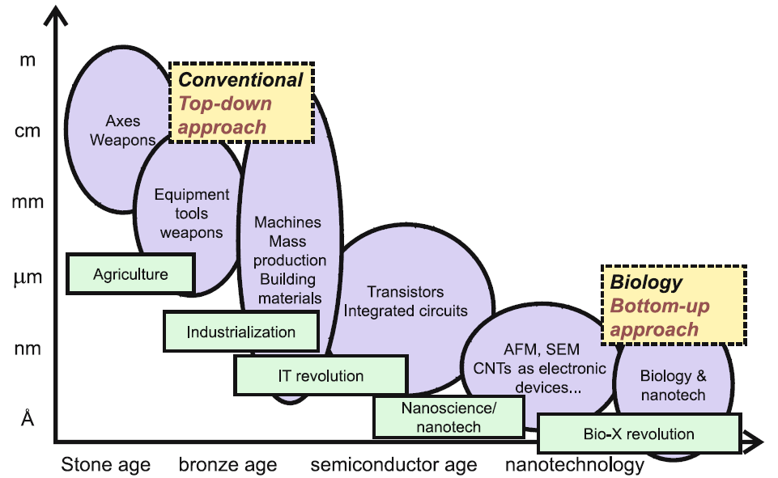
Enhanced modelling has made humanity transition from top-down to bottom-up approach of technology development
Ref: Buehler, Markus J., ed. Atomistic modeling of materials failure. Boston, MA: Springer US, 2008.

Slide 5
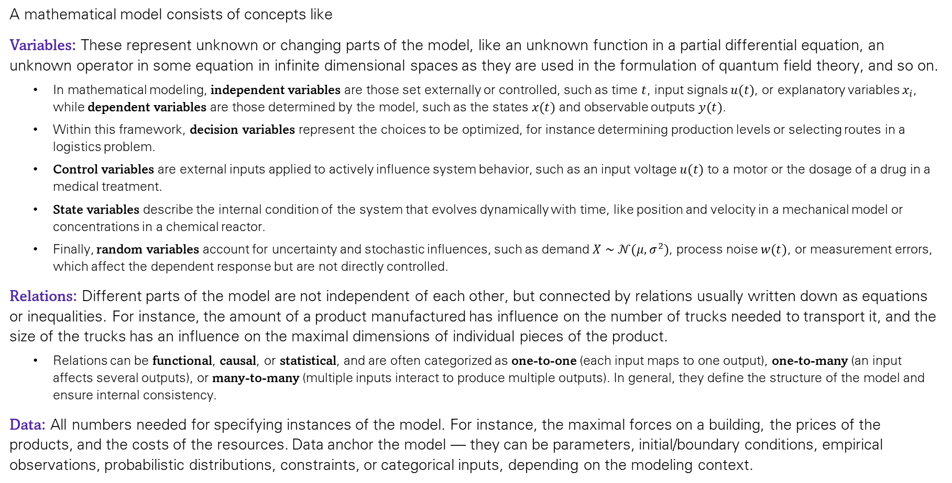
Constitution of a Mathematical Model
A mathematical model consists of concepts like
Variables: These represent unknown or changing parts of the model, like an unknown function in a partial differential equation, an unknown operator in some equation in infinite dimensional spaces as they are used in the formulation of quantum field theory, and so on.
  In mathematical modeling, independent variables are those set externally or controlled, such as time $t$, input signals $u(t)$, or explanatory variables $x_{i}$​, while dependent variables are those determined by the model, such as the states $x(t)$ and observable outputs $y(t)$.
  Within this framework, decision variables represent the choices to be optimized, for instance determining production levels or selecting routes in a logistics problem.
  Control variables are external inputs applied to actively influence system behavior, such as an input voltage $u(t)$ to a motor or the dosage of a drug in a medical treatment.
  State variables describe the internal condition of the system that evolves dynamically with time, like position and velocity in a mechanical model or concentrations in a chemical reactor.
  Finally, random variables account for uncertainty and stochastic influences, such as demand $X∼𝒩(μ,σ^{2})$, process noise $w(t)$, or measurement errors, which affect the dependent response but are not directly controlled.
Relations: Different parts of the model are not independent of each other, but connected by relations usually written down as equations or inequalities. For instance, the amount of a product manufactured has influence on the number of trucks needed to transport it, and the size of the trucks has an influence on the maximal dimensions of individual pieces of the product.
  Relations can be functional, causal, or statistical, and are often categorized as one-to-one (each input maps to one output), one-to-many (an input affects several outputs), or many-to-many (multiple inputs interact to produce multiple outputs). In general, they define the structure of the model and ensure internal consistency.
Data: All numbers needed for specifying instances of the model. For instance, the maximal forces on a building, the prices of the products, and the costs of the resources. Data anchor the model — they can be parameters, initial/boundary conditions, empirical observations, probabilistic distributions, constraints, or categorical inputs, depending on the modeling context.

Slide 6
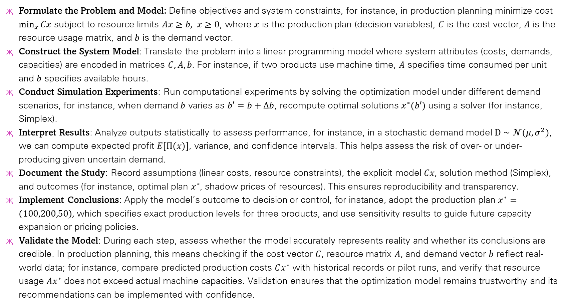
The Modelling Process
Formulate the Problem and Model: Define objectives and system constraints, for instance, in production planning minimize cost $\min_{x}{Cx}$ subject to resource limits $Ax≥b, x≥0$, where $x$ is the production plan (decision variables), $C$ is the cost vector, $A$ is the resource usage matrix, and $b$ is the demand vector.
Construct the System Model: Translate the problem into a linear programming model where system attributes (costs, demands, capacities) are encoded in matrices $C,A,b$. For instance, if two products use machine time, $A$ specifies time consumed per unit and $b$ specifies available hours.
Conduct Simulation Experiments: Run computational experiments by solving the optimization model under different demand scenarios, for instance, when demand $b$ varies as $b′=b+Δb$, recompute optimal solutions $x^{∗}(b′)$ using a solver (for instance, Simplex).
Interpret Results: Analyze outputs statistically to assess performance, for instance, in a stochastic demand model $D∼𝒩(μ,σ^{2})$, we can compute expected profit $E[Π(x)]$, variance, and confidence intervals. This helps assess the risk of over- or under-producing given uncertain demand.
Document the Study: Record assumptions (linear costs, resource constraints), the explicit model $Cx$, solution method (Simplex), and outcomes (for instance, optimal plan $x^{∗}$, shadow prices of resources). This ensures reproducibility and transparency.
Implement Conclusions: Apply the model’s outcome to decision or control, for instance, adopt the production plan $x^{∗}=\left(100,200,50\right),$ which specifies exact production levels for three products, and use sensitivity results to guide future capacity expansion or pricing policies.
Validate the Model: During each step, assess whether the model accurately represents reality and whether its conclusions are credible. In production planning, this means checking if the cost vector $C$, resource matrix $A$, and demand vector $b$ reflect real-world data; for instance, compare predicted production costs $Cx^{∗}$ with historical records or pilot runs, and verify that resource usage $Ax^{∗}$ does not exceed actual machine capacities. Validation ensures that the optimization model remains trustworthy and its recommendations can be implemented with confidence.

Slide 7
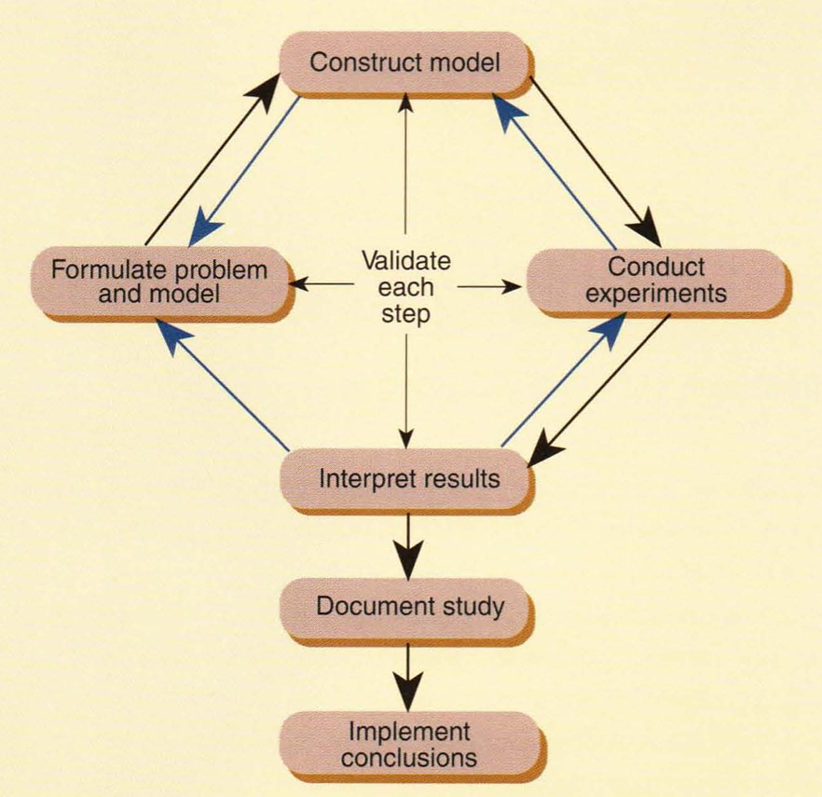
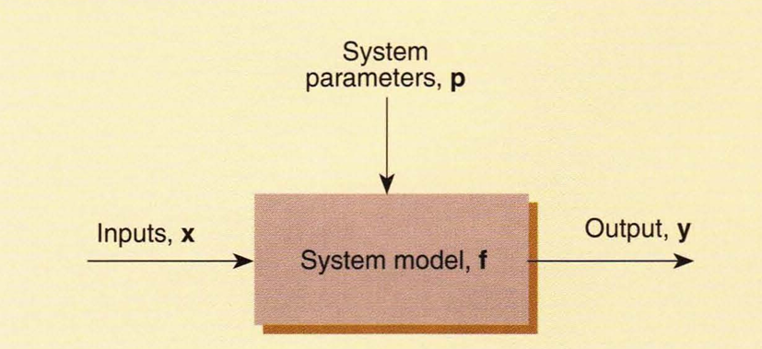

$$y=f(x,p)$$
Modelling
Process
Functional view of system models
Ref: W. A. Menner, “Introduction to Modeling and Simulation”. John Hopkins APL Technical Digest, Volume 16, Number 1 (1995)

Slide 8
Formulation of the Problem
Problem Statement
A problem statement defines the system under study by specifying its inputs, system parameters, and outputs. It sets the foundation for the modeling process by clarifying what aspects of the system are being analyzed and how they will be represented.
System Examination
Because complex systems involve many interrelated phenomena, the system is often broken down hierarchically into subsystems. Each subsystem is described in terms of its input, output, and processing, as well as its relationship to the overall system and other subsystems. This characterization may require manuals, expert discussions, direct observation, or specialized data collection.
Objectives and Goals
The problem statement should list objectives clearly and precisely, since ambiguous goals prevent actionable conclusions. For instance, in communications networks, objectives could include determining the best packet size, routing strategy, queuing protocol, or number of switching stations.
Requirements and Constraints
Requirements define necessary performance levels and operating conditions, while constraints often reflect practical limitations. For example, military networks may require lower bounds on throughput and upper bounds on delay, while constraints may include transmitter duty cycles, funding, or hardware availability.
Assumptions
Assumptions are made to simplify analysis by abstracting unnecessary details. For example, in modeling message timeliness, the detailed bit-level operations at switching stations may be replaced with an average processing delay. Such assumptions often arise during model formulation or from lessons learned in prior studies.

Slide 9
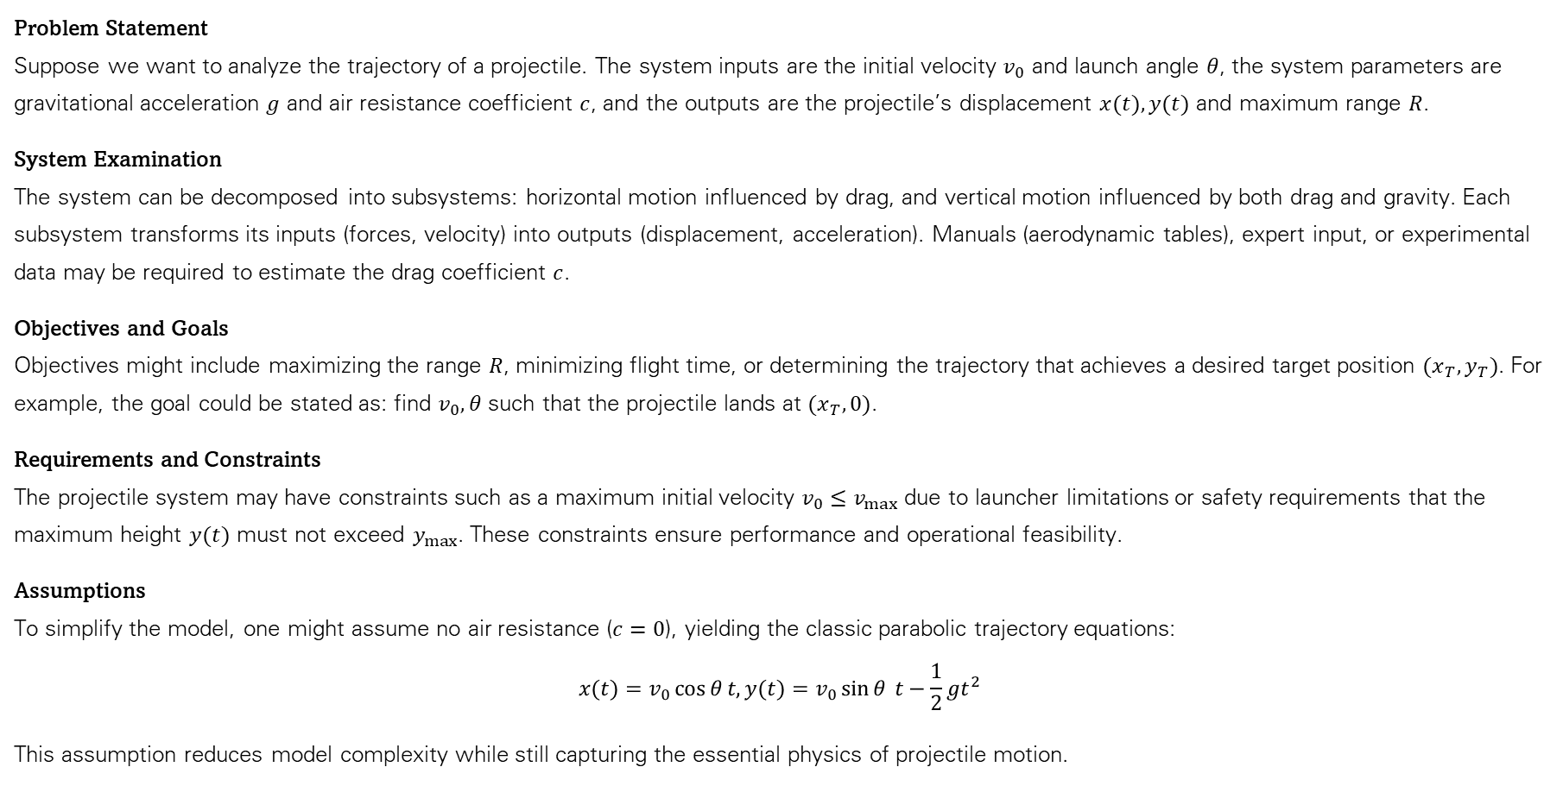
Example of Problem Formulation: Projectiles
Problem Statement
Suppose we want to analyze the trajectory of a projectile. The system inputs are the initial velocity $v_{0}$​ and launch angle $θ$, the system parameters are gravitational acceleration $g$ and air resistance coefficient $c$, and the outputs are the projectile’s displacement $x(t),y(t)$ and maximum range $R$.
System Examination
The system can be decomposed into subsystems: horizontal motion influenced by drag, and vertical motion influenced by both drag and gravity. Each subsystem transforms its inputs (forces, velocity) into outputs (displacement, acceleration). Manuals (aerodynamic tables), expert input, or experimental data may be required to estimate the drag coefficient $c$.
Objectives and Goals
Objectives might include maximizing the range $R$, minimizing flight time, or determining the trajectory that achieves a desired target position $(x_{T},y_{T})$. For example, the goal could be stated as: find $v_{0},θ$ such that the projectile lands at $(x_{T},0)$.
Requirements and Constraints
The projectile system may have constraints such as a maximum initial velocity $v_{0}≤v_{max}$​ due to launcher limitations or safety requirements that the maximum height $y(t)$ must not exceed $y_{max}$​. These constraints ensure performance and operational feasibility.
Assumptions
To simplify the model, one might assume no air resistance ($c=0$), yielding the classic parabolic trajectory equations:
$$x(t)=v_{0}\cos{θ}t,y(t)=v_{0}\sin{θ} t−\frac{1}{2}gt^{2}$$
This assumption reduces model complexity while still capturing the essential physics of projectile motion.

Slide 10
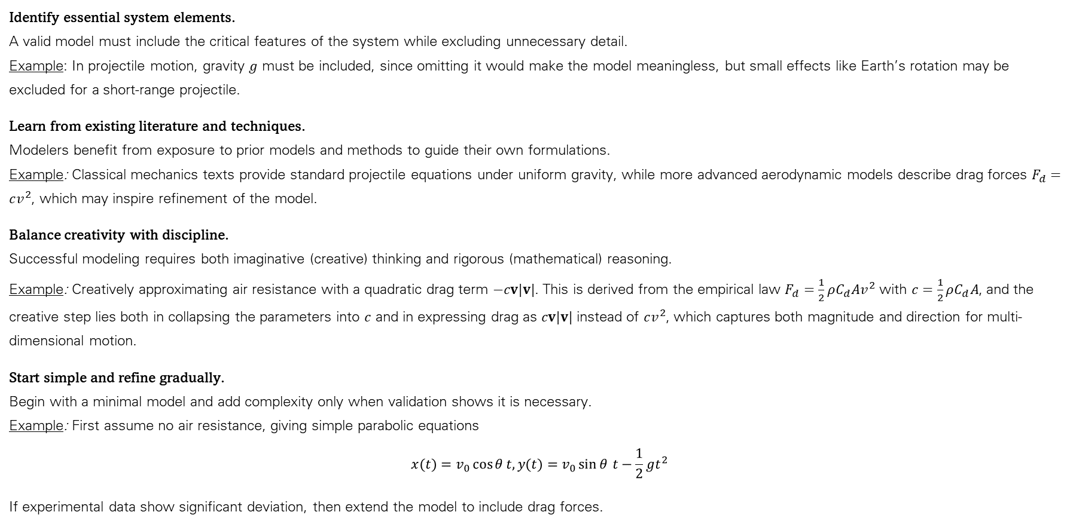
Model Formulation, with Projectile Illustration
Identify essential system elements.
A valid model must include the critical features of the system while excluding unnecessary detail.
Example: In projectile motion, gravity $g$ must be included, since omitting it would make the model meaningless, but small effects like Earth’s rotation may be excluded for a short-range projectile.
Learn from existing literature and techniques.
Modelers benefit from exposure to prior models and methods to guide their own formulations.
Example: Classical mechanics texts provide standard projectile equations under uniform gravity, while more advanced aerodynamic models describe drag forces $F_{d}=cv^{2}$, which may inspire refinement of the model.
Balance creativity with discipline.
Successful modeling requires both imaginative (creative) thinking and rigorous (mathematical) reasoning.
Example: Creatively approximating air resistance with a quadratic drag term $−cv|v|$. This is derived from the empirical law $F_{d}=\frac{1}{2}ρC_{d}Av^{2}$ with $c=\frac{1}{2}ρC_{d}A$, and the creative step lies both in collapsing the parameters into $c$ and in expressing drag as $cv|v|$ instead of $cv^{2}$, which captures both magnitude and direction for multi-dimensional motion.
Start simple and refine gradually.
Begin with a minimal model and add complexity only when validation shows it is necessary.
Example: First assume no air resistance, giving simple parabolic equations
$$x(t)=v_{0}\cos{θ}t,y(t)=v_{0}\sin{θ} t−\frac{1}{2}gt^{2}$$
If experimental data show significant deviation, then extend the model to include drag forces.

Slide 11
The last part of the formulation step involves the search for an appropriate solution technique.
Note: Model formulation is the process of expressing a real system as a precise mathematical structure (for instance, ODEs, PDEs, algebraic/optimization constraints)—for example, the projectile-with-quadratic-drag model, whereas the appropriate solution technique is the choice of an analytical approximation or an approximate numerical/simulation method (for instance, a Runge–Kutta integrator such as RK4/ode45) used to extract trajectories and quantitative insights from that formulation.
This search should be exhaustive, and the technique chosen should exhibit the highest benefit-to-cost ratio (the chosen one should provide the greatest accuracy, insight, and usefulness/benefit relative to the effort, computational resources, time, and complexity/cost required to apply it)
Analytical solutions generally are preferred because they are exact.
Unfortunately, the vast complexity of many systems precludes the use of analytical solution techniques.
For such systems, simulation may be the only effective solution method.

Slide 12
Solution Techniques (Analytical/Closed-Form)
Method | Description | Applicability / Assumptions
Closed-form algebraic solution | Solve equations exactly using algebraic manipulation and known functions (polynomials, exponentials, trigonometric, special functions) | Linear or nonlinear ODEs/PDEs where integrable in terms of known functions
Separation of Variables | Decompose PDE/ODE into products of functions each depending on a single variable | Linear PDEs with separable boundary/initial conditions
Laplace Transform | Transforms ODE/PDE into algebraic equations in complex frequency domain | Linear ODEs with initial conditions, semi-infinite domains
Fourier Transform / Fourier Series | Expands functions in sines/cosines; transforms differential operators into algebraic multipliers | Linear PDEs on infinite or periodic domains
Green’s Function Method | Constructs solution as convolution of source with system’s impulse response | Linear PDEs/ODEs with well-posed boundary conditions
Method of Characteristics | Reduces first-order PDEs to ODEs along characteristic curves | Quasilinear first-order PDEs
Lie Group / Symmetry Analysis | Uses continuous symmetries to reduce order or dimension of differential equations | Nonlinear ODEs/PDEs with identifiable symmetry groups
Integral Equation Reformulation | Express PDE/ODE as an equivalent integral equation | Linear or nonlinear problems where kernels are well-defined

Slide 13
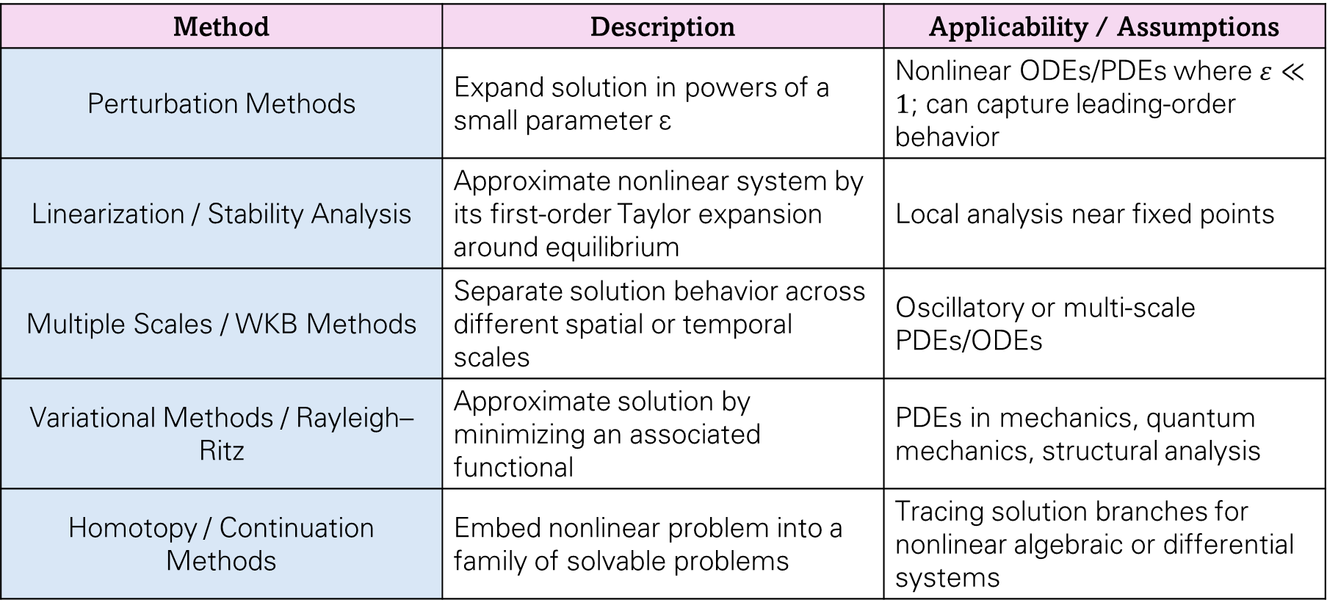
Solution Techniques (Approximate/Perturbative)
Method | Description | Applicability / Assumptions
Perturbation Methods | Expand solution in powers of a small parameter ε | Nonlinear ODEs/PDEs where $ε≪1$; can capture leading-order behavior
Linearization / Stability Analysis | Approximate nonlinear system by its first-order Taylor expansion around equilibrium | Local analysis near fixed points
Multiple Scales / WKB Methods | Separate solution behavior across different spatial or temporal scales | Oscillatory or multi-scale PDEs/ODEs
Variational Methods / Rayleigh–Ritz | Approximate solution by minimizing an associated functional | PDEs in mechanics, quantum mechanics, structural analysis
Homotopy / Continuation Methods | Embed nonlinear problem into a family of solvable problems | Tracing solution branches for nonlinear algebraic or differential systems

Slide 14
Solution Techniques (Numerical/Discretization)
Method | Description | Applicability / Assumptions
Finite Difference Method (FDM) | Approximate derivatives using differences on a grid | Structured grids, moderate accuracy
Finite Element Method (FEM) | Decompose domain into elements, approximate solution with basis functions | Complex geometries, variational problems
Boundary Element Method (BEM) | Discretize only domain boundaries | Linear PDEs with simple Green’s functions; reduces dimensionality
Spectral / Pseudospectral Methods | Expand solution in orthogonal global basis (e.g., Chebyshev, Fourier) | Smooth solutions, periodic or bounded domains
Runge–Kutta Methods | Stepwise ODE integration with controlled truncation error | Initial value ODE problems
Multigrid Methods | Solve discretized PDEs on hierarchical grids for rapid convergence | Elliptic PDEs on structured/unstructured grids
Adaptive Mesh Refinement (AMR) | Refine grid dynamically in regions of high gradients | Hyperbolic/elliptic PDEs with localized phenomena
Operator Splitting / Fractional Step | Decompose PDE into simpler sub-problems | Complex PDEs (advection-diffusion-reaction)

Slide 15
Solution Techniques (Stochastic/Probabilistic)
Method | Description | Applicability / Assumptions
Monte Carlo Simulation | Use repeated random sampling to estimate solution statistics | High-dimensional problems, stochastic ODEs/PDEs
Stochastic Differential Equation (SDE) Solvers | Numerical integration of SDEs using stochastic calculus (e.g., Euler–Maruyama) | Systems with white noise or Brownian motion terms
Solution Techniques (Optimization-based/Data-Driven)
Method | Description | Applicability / Assumptions
Optimization-based Solvers | Reformulate differential/algebraic system as extremization problem | Gradient descent, constrained nonlinear programming
Reduced-order / Surrogate Modeling | Approximate high-dimensional system with low-dimensional representation | Parametric PDEs, real-time simulation
Physics-Informed Neural Networks (PINNs) | Train neural networks to satisfy differential equations and boundary conditions | Complex nonlinear PDEs, sparse or noisy data

Slide 16
Limitations of Modelling
Simplifying Assumptions and Idealizations: All models intentionally simplify reality by neglecting certain variables, interactions, or nonlinearities. While these abstractions make problems tractable, they can lead to inaccuracies when the excluded factors become significant. For example, assuming laminar flow in a fluid model fails to capture turbulence effects at high velocities.
Parameter Uncertainty: Models rely on input parameters that are often estimated, measured with error, or derived from incomplete data. Even small errors in these parameters can propagate through the model, potentially resulting in significant deviations from real-world behavior. For instance, ecological population models are highly sensitive to uncertainties in birth and death rates.
Structural Uncertainty: Beyond parameter errors, the underlying mathematical structure of a model may not fully capture the true dynamics of the system. Structural inadequacy means that even perfectly measured inputs may not produce accurate predictions. An example is using linear elasticity to model materials that exhibit plastic deformation under high stress.
Computational Limitations: Numerical models introduce errors through discretization, finite precision, and approximations. High-fidelity simulations can be computationally expensive, sometimes prohibitive, forcing compromises on resolution or time-stepping. For example, simulating turbulent flows requires extremely fine grids, which may be impractical on available hardware.
Overfitting and Model Complexity Trade-off: Increasing model complexity can improve fit to historical data but reduce predictive generalizability. Overfitted models may capture noise rather than underlying system behavior, leading to poor performance on new scenarios. Neural networks with excessive parameters trained on limited datasets are a classic example.
Scale and Resolution Constraints: Models often operate at specific spatial or temporal scales, averaging or parameterizing smaller-scale effects. This can miss critical subgrid dynamics or interactions. Climate models, for example, cannot resolve individual thunderstorms, requiring parameterization of their aggregate effects.
Nonlinearity and Chaos: Nonlinear systems can exhibit sensitive dependence on initial conditions, meaning tiny uncertainties can grow exponentially over time. As a result, long-term predictions become inherently unreliable, even if the model equations are exact. Weather forecasting beyond approximately two weeks is fundamentally limited by such chaotic behavior.
Boundary and Initial Condition Sensitivity: The accuracy of a model is highly dependent on its initial and boundary conditions. Errors or uncertainties in these inputs can amplify over time, producing divergent predictions. Ocean circulation models, for instance, are extremely sensitive to initial temperature and salinity distributions.
Data Limitations: Models often require observational or experimental data for calibration, validation, and forcing. When data are sparse, noisy, or biased, model reliability suffers. Early-stage epidemiological models are particularly vulnerable, as limited infection data can lead to widely divergent projections.
Inadequate Representation of Uncertainty: Many models produce deterministic outputs, neglecting variability and stochastic effects inherent in real systems. Ignoring probabilistic phenomena can misrepresent risks or extreme events. For example, deterministic flood models cannot adequately capture the probabilistic nature of storm surge or rare rainfall events.

Slide 17
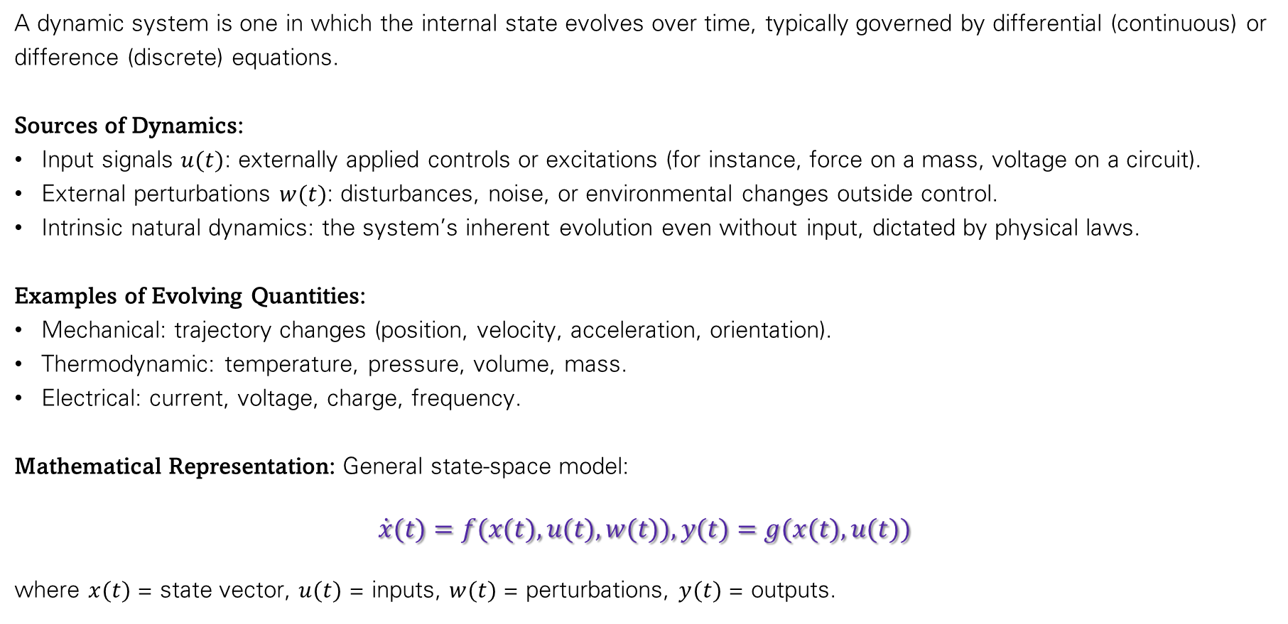
What is a Dynamic System?
A dynamic system is one in which the internal state evolves over time, typically governed by differential (continuous) or difference (discrete) equations.
Sources of Dynamics:
Input signals $u(t)$: externally applied controls or excitations (for instance, force on a mass, voltage on a circuit).
External perturbations $w(t)$: disturbances, noise, or environmental changes outside control.
Intrinsic natural dynamics: the system’s inherent evolution even without input, dictated by physical laws.
Examples of Evolving Quantities:
Mechanical: trajectory changes (position, velocity, acceleration, orientation).
Thermodynamic: temperature, pressure, volume, mass.
Electrical: current, voltage, charge, frequency.
Mathematical Representation: General state-space model:
$$\dot{x}(t)=f(x(t),u(t),w(t)),y(t)=g(x(t),u(t))$$
where $x(t)$ = state vector, $u(t)$ = inputs, $w(t)$ = perturbations, $y(t)$ = outputs.

Slide 18



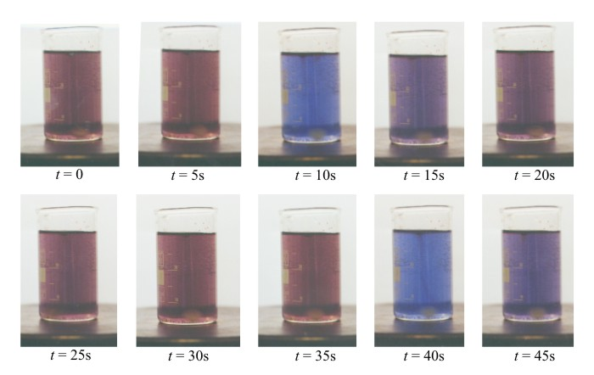

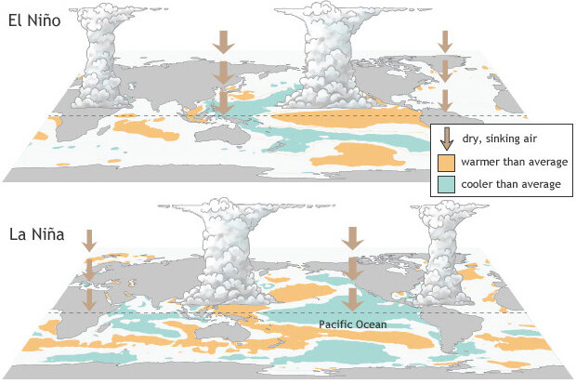

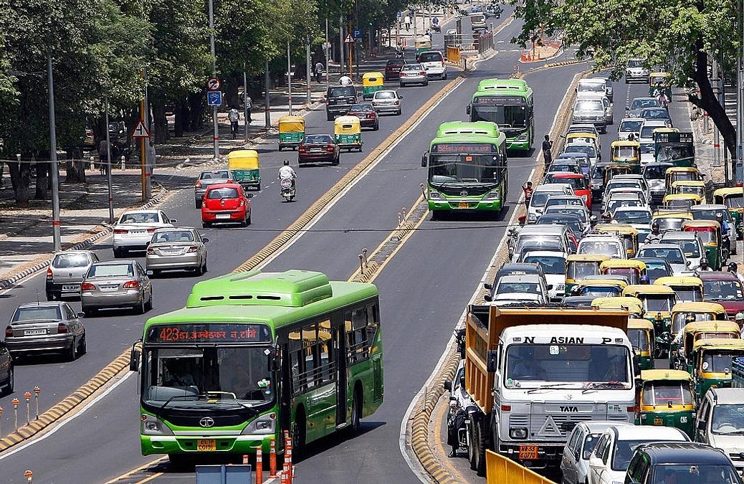
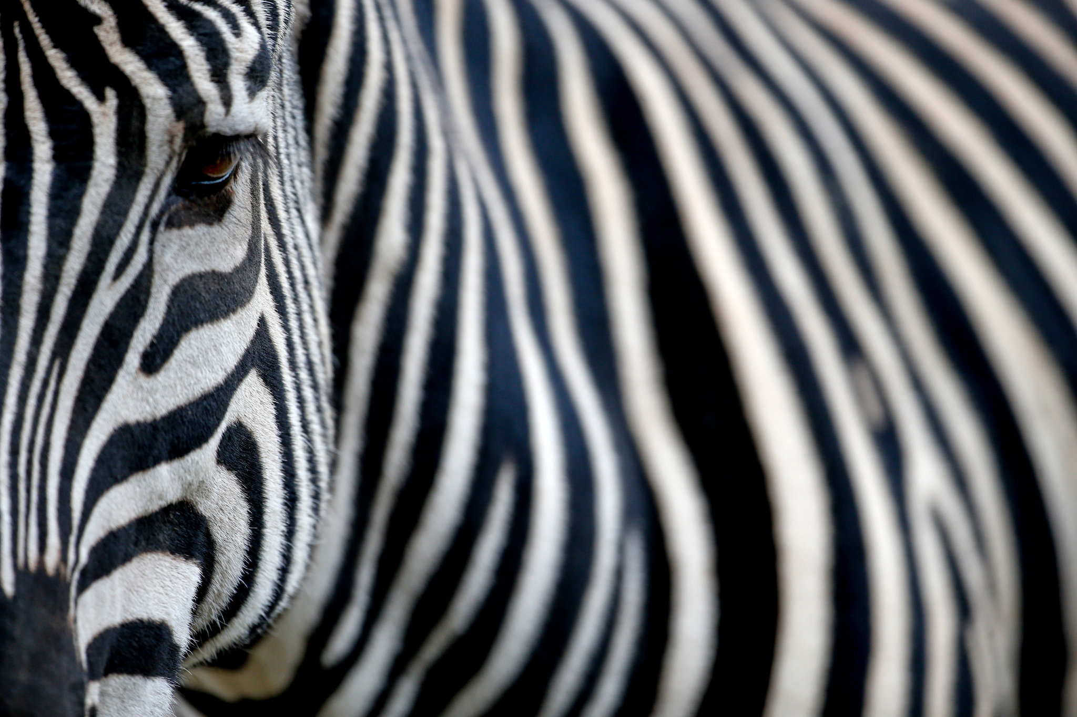
ENSO

Slide 19
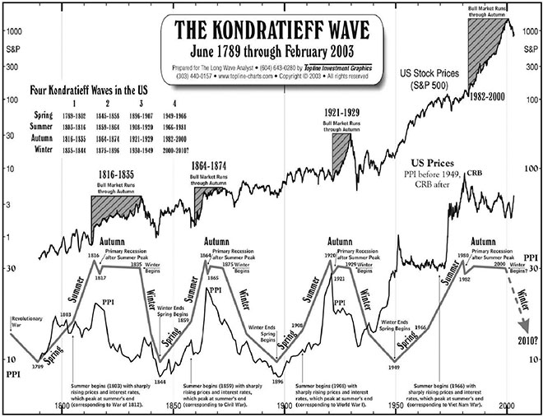

Slide 20
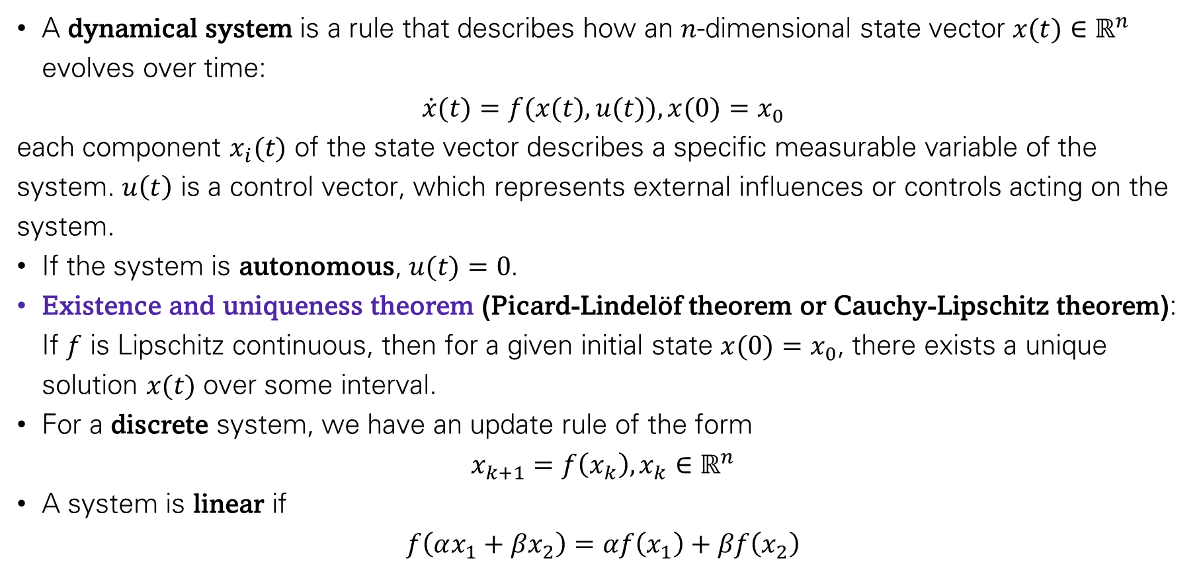
Foundations of Dynamical Systems
A dynamical system is a rule that describes how an $n$-dimensional state vector $x(t)∈ℝ^{n}$ evolves over time:
$\dot{x}(t)=f(x(t),u(t)),x(0)=x_{0}$​
each component $x_{i}(t)$ of the state vector describes a specific measurable variable of the system. $u\left(t\right)$ is a control vector, which represents external influences or controls acting on the system.
If the system is autonomous, $u(t)=0$.
Existence and uniqueness theorem (Picard-Lindelöf theorem or Cauchy-Lipschitz theorem): If $f$ is Lipschitz continuous, then for a given initial state $x(0)=x_{0}​$, there exists a unique solution $x(t)$ over some interval.
For a discrete system, we have an update rule of the form
$$x_{k+1}=f\left(x_{k}\right),x_{k}∈ℝ^{n}$$
A system is linear if
$$f\left(αx_{1}+βx_{2}\right)=αf\left(x_{1}\right)+βf\left(x_{2}\right)$$

Slide 21
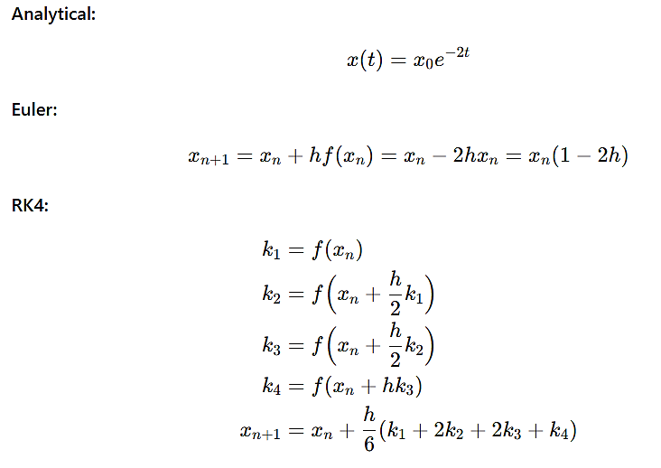
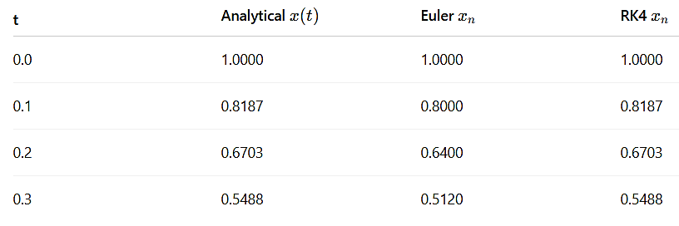
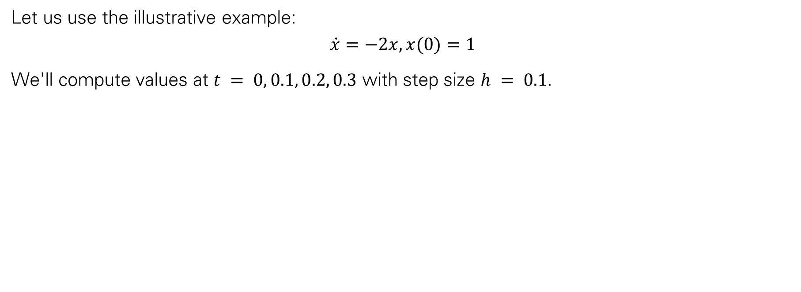
Using Numerical and Analytical Methods for Differential Equations in Dynamical Systems (Example)
Let us use the illustrative example:
$$\dot{x}=−2x,x(0)=1$$
We'll compute values at $t = 0, 0.1, 0.2, 0.3$ with step size $h = 0.1$.
Observations
Euler method underestimates decay (first-order method).
RK4 method is highly accurate (fourth-order), nearly identical to analytical solution.
Smaller step size improves Euler accuracy, but RK4 is more robust for larger steps.

Slide 22
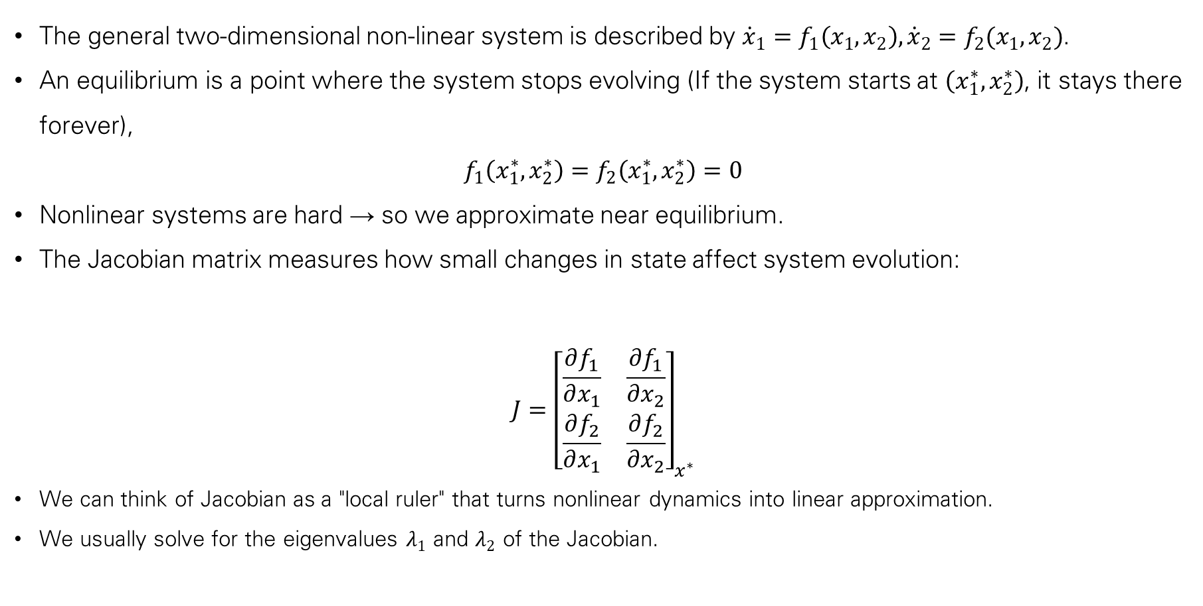
Phase Plane Analysis (2D Nonlinear System)
The general two-dimensional non-linear system is described by ${\dot{x}}_{1}=f_{1}\left(x_{1},x_{2}\right),{\dot{x}}_{2}=f_{2}(x_{1},x_{2})$.
An equilibrium is a point where the system stops evolving (If the system starts at $\left(x_{1}^{∗},x_{2}^{∗}\right)$, it stays there forever),
$$f_{1}\left(x_{1}^{∗},x_{2}^{∗}\right)=f_{2}\left(x_{1}^{∗},x_{2}^{∗}\right)=0$$
Nonlinear systems are hard → so we approximate near equilibrium.
The Jacobian matrix measures how small changes in state affect system evolution:
$$J={\left[\begin{matrix}\frac{∂f_{1}}{∂x_{1}} & \frac{∂f_{1}}{∂x_{2}} \\ \frac{∂f_{2}}{∂x_{1}} & \frac{∂f_{2}}{∂x_{2}}\end{matrix}\right]}_{x^{∗}}$$
We can think of Jacobian as a "local ruler" that turns nonlinear dynamics into linear approximation.
We usually solve for the eigenvalues $λ_{1}$ and $λ_{2}$ of the Jacobian.

Slide 23
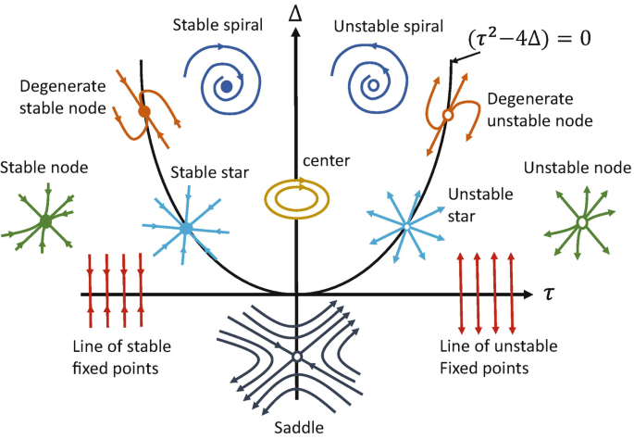
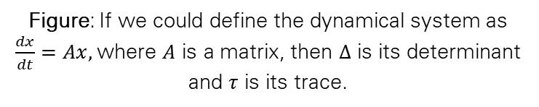
Phase Plane Analysis (2D Nonlinear System)
Interpretation:
  Both negative → trajectories shrink into point (Stable Node).
  Both positive → trajectories move away (Unstable Node).
  Opposite signs → some directions stable, others unstable (Saddle Point).
  Complex with negative real part → spiral inward (Stable Focus).
  Complex with positive real part → spiral outward (Unstable Focus).
  Purely imaginary → closed orbits (Center).
The intuition is that the eigenvalues tell us if perturbations ‘die out’ or ‘explode’.
Figure: If we could define the dynamical system as $\frac{dx}{dt}=Ax,$where $A$ is a matrix, then $Δ$ is its determinant and $τ$ is its trace.

Slide 24
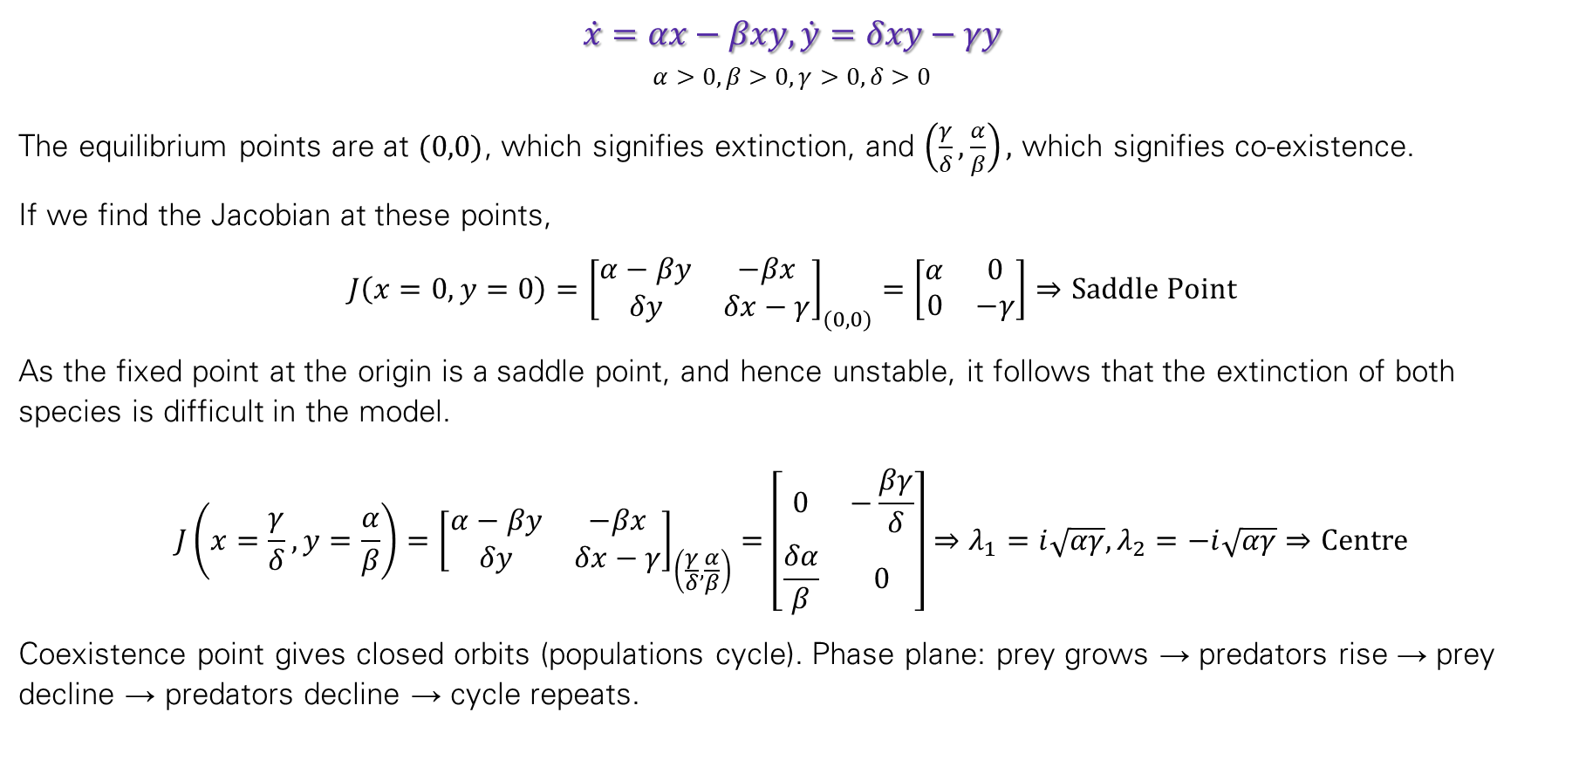
Example: Lotka–Volterra Predator–Prey Model
$$\dot{x}=αx−βxy, \dot{y}=δxy−γy$$
$$α>0,β>0,γ>0,δ>0$$
The equilibrium points are at $(0,0)$, which signifies extinction, and $\left(\frac{γ}{δ},\frac{α}{β}\right),$ which signifies co-existence.
If we find the Jacobian at these points,
$$J\left(x=0,y=0\right)={\left[\begin{matrix}α−βy & −βx \\ δy & δx−γ\end{matrix}\right]}_{(0,0)}=\left[\begin{matrix}α & 0 \\ 0 & −γ\end{matrix}\right]⇒Saddle Point$$
As the fixed point at the origin is a saddle point, and hence unstable, it follows that the extinction of both species is difficult in the model.
$$J\left(x=\frac{γ}{δ},y=\frac{α}{β}\right)={\left[\begin{matrix}α−βy & −βx \\ δy & δx−γ\end{matrix}\right]}_{\left(\frac{γ}{δ},\frac{α}{β}\right)}=\left[\begin{matrix}0 & −\frac{βγ}{δ} \\ \frac{δα}{β} & 0\end{matrix}\right]⇒λ_{1}=i\sqrt{αγ},λ_{2}=−i\sqrt{αγ}⇒Centre$$
Coexistence point gives closed orbits (populations cycle). Phase plane: prey grows → predators rise → prey decline → predators decline → cycle repeats.

Slide 25
MATLAB Implementation
% Lotka–Volterra Predator-Prey Model
% dx/dt = alpha*x - beta*x*y
% dy/dt = delta*x*y - gamma*y
clear; clc; close all;
% Parameters
alpha = 1.0; % prey growth rate
beta = 0.5; % predation rate
delta = 0.5; % predator growth rate
gamma = 2.0; % predator death rate
% Define system of ODEs
f = @(x) [alpha*x(1) - beta*x(1)*x(2);
delta*x(1)*x(2) - gamma*x(2)];
% --- Step 1: Equilibria ---
% Solve f(x) = 0
x_eq = [0 0; gamma/delta, alpha/beta];
disp('Equilibria (x*, y*):');
disp(x_eq);
% --- Step 2: Jacobian at equilibria ---
syms x y
f1 = alpha*x - beta*x*y;
f2 = delta*x*y - gamma*y;
J = jacobian([f1; f2], [x y]);
for i = 1:size(x_eq,1)
J_eval = double(subs(J, {x,y}, {x_eq(i,1), x_eq(i,2)}));
eigvals = eig(J_eval);
fprintf('Equilibrium %d: (%f,%f), Eigenvalues = %s\n', ...
i, x_eq(i,1), x_eq(i,2), mat2str(eigvals,4));
end
% --- Step 3: RK4 Simulation ---
dt = 0.01; T = 50;
N = floor(T/dt);
x = zeros(2,N);
% Initial condition (not at equilibrium)
x(:,1) = [2; 1];
for n = 1:N-1
k1 = f(x(:,n));
k2 = f(x(:,n) + 0.5*dt*k1);
k3 = f(x(:,n) + 0.5*dt*k2);
k4 = f(x(:,n) + dt*k3);
x(:,n+1) = x(:,n) + dt/6*(k1 + 2*k2 + 2*k3 + k4);
end
% --- Step 4: Phase Plane Plot ---
[x1,x2] = meshgrid(0:0.5:6, 0:0.5:6);
u = alpha*x1 - beta.*x1.*x2;
v = delta.*x1.*x2 - gamma*x2;
figure;
quiver(x1,x2,u,v,'r'); hold on; % vector field
plot(x(1,:), x(2,:), 'b','LineWidth',1.5); % trajectory
plot(x_eq(:,1), x_eq(:,2),'ko','MarkerFaceColor','k','MarkerSize',8); % equilibria
xlabel('Prey Population (x)');
ylabel('Predator Population (y)');
title('Phase Plane: Lotka–Volterra Predator–Prey');
legend('Vector Field','Trajectory','Equilibria');
grid on; axis tight;

Slide 26
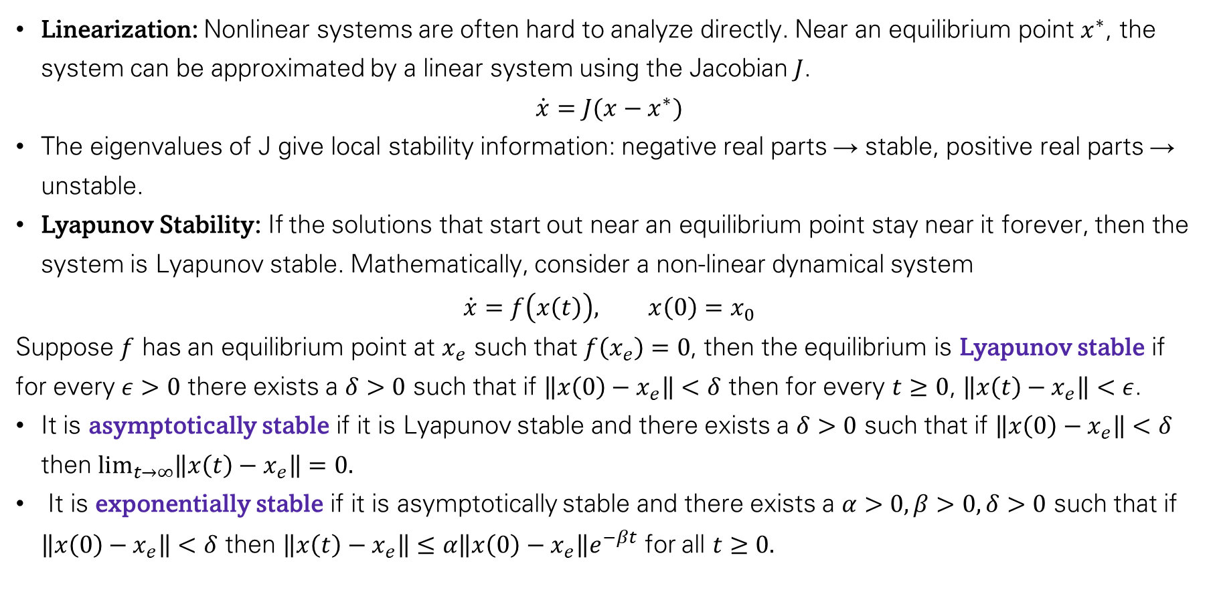
Stability and Lyapunov Analysis
Linearization: Nonlinear systems are often hard to analyze directly. Near an equilibrium point $x^{∗}$, the system can be approximated by a linear system using the Jacobian $J$.
$$\dot{x}=J(x−x^{∗})$$
The eigenvalues of J give local stability information: negative real parts → stable, positive real parts → unstable.
Lyapunov Stability: If the solutions that start out near an equilibrium point stay near it forever, then the system is Lyapunov stable. Mathematically, consider a non-linear dynamical system
$$\dot{x}=f\left(x\left(t\right)\right), x\left(0\right)=x_{0}$$
Suppose $f$ has an equilibrium point at $x_{e}$ such that $f\left(x_{e}\right)=0$, then the equilibrium is Lyapunov stable if for every $ε>0$ there exists a $δ>0$ such that if $\left\|x\left(0\right)−x_{e}\right\|<δ$ then for every $t≥0$, $\left\|x\left(t\right)−x_{e}\right\|<ε$.
It is asymptotically stable if it is Lyapunov stable and there exists a $δ>0$ such that if $\left\|x\left(0\right)−x_{e}\right\|<δ$ then $\lim_{t→∞}\left\|x\left(t\right)−x_{e}\right\|=0.$
It is exponentially stable if it is asymptotically stable and there exists a $α>0,β>0,δ>0$ such that if $\left\|x\left(0\right)−x_{e}\right\|<δ$ then $\left\|x\left(t\right)−x_{e}\right\|≤α\left\|x\left(0\right)−x_{e}\right\|e^{−βt}$ for all $t≥0.$

Slide 27
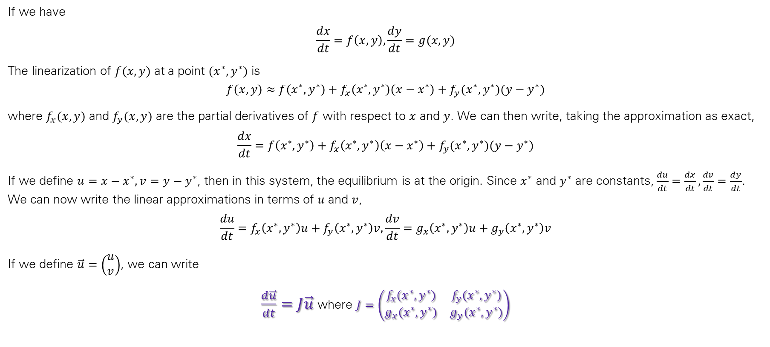
Linearization at an Equilibrium Point of a System of Differential Equations
If we have
$$\frac{dx}{dt}=f\left(x,y\right),\frac{dy}{dt}=g(x,y)$$
The linearization of $f(x,y)$ at a point $(x^{∗},y^{∗})$ is
$$f\left(x,y\right)≈f\left(x^{∗},y^{∗}\right)+f_{x}\left(x^{∗},y^{∗}\right)\left(x−x^{∗}\right)+f_{y}(x^{∗},y^{∗})(y−y^{∗})$$
where $f_{x}(x,y)$ and $f_{y}(x,y)$ are the partial derivatives of $f$ with respect to $x$ and $y$. We can then write, taking the approximation as exact,
$$\frac{dx}{dt}=f\left(x^{∗},y^{∗}\right)+f_{x}\left(x^{∗},y^{∗}\right)\left(x−x^{∗}\right)+f_{y}(x^{∗},y^{∗})(y−y^{∗})$$
If we define $u=x−x^{∗}, v=y−y^{∗}$, then in this system, the equilibrium is at the origin. Since $x^{∗}$ and $y^{∗}$ are constants, $\frac{du}{dt}=\frac{dx}{dt},\frac{dv}{dt}=\frac{dy}{dt}$. We can now write the linear approximations in terms of $u$ and $v$,
$$\frac{du}{dt}=f_{x}\left(x^{∗},y^{∗}\right)u+f_{y}\left(x^{∗},y^{∗}\right)v,\frac{dv}{dt}=g_{x}\left(x^{∗},y^{∗}\right)u+g_{y}\left(x^{∗},y^{∗}\right)v$$
If we define $\vec{u}=\left(\begin{matrix}u \\ v\end{matrix}\right)$, we can write
$\frac{d\vec{u}}{dt}=J\vec{u}$ where $J=\left(\begin{matrix}f_{x}(x^{∗},y^{∗}) & f_{y}(x^{∗},y^{∗}) \\ g_{x}(x^{∗},y^{∗}) & g_{y}(x^{∗},y^{∗})\end{matrix}\right)$

Slide 28
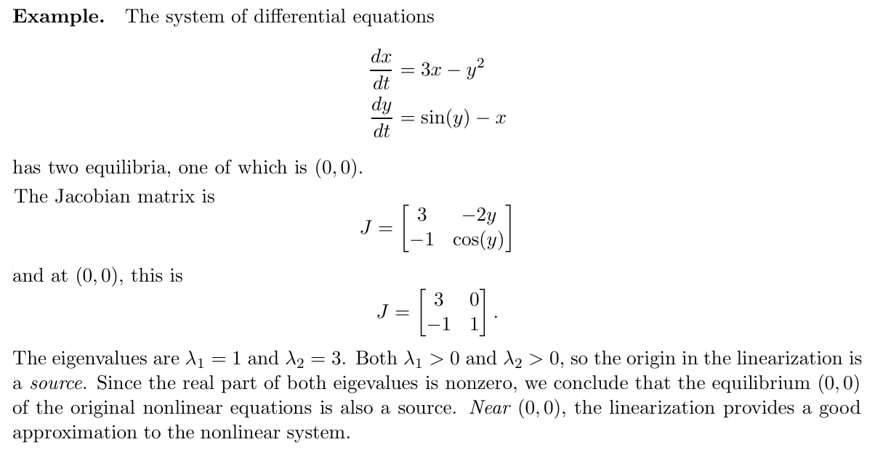

Slide 29
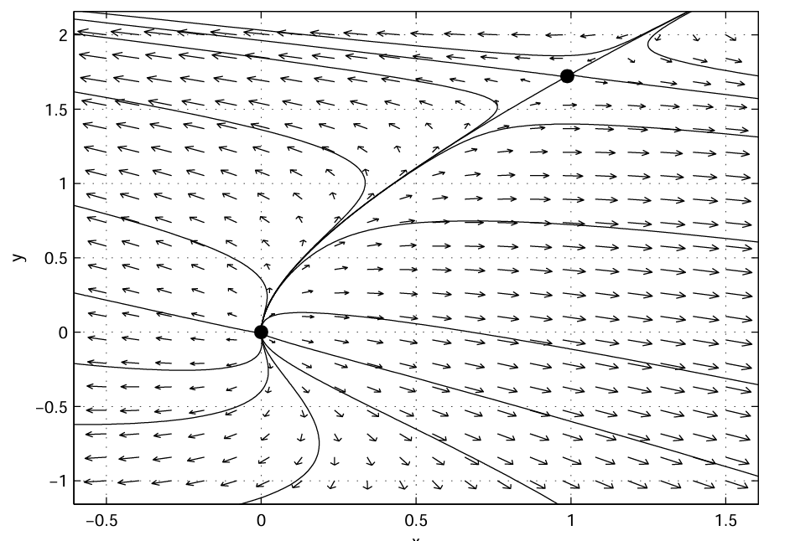

Slide 30
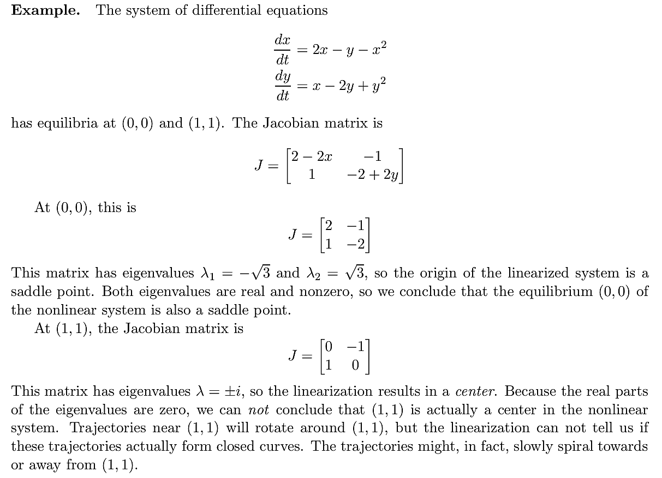

Slide 31
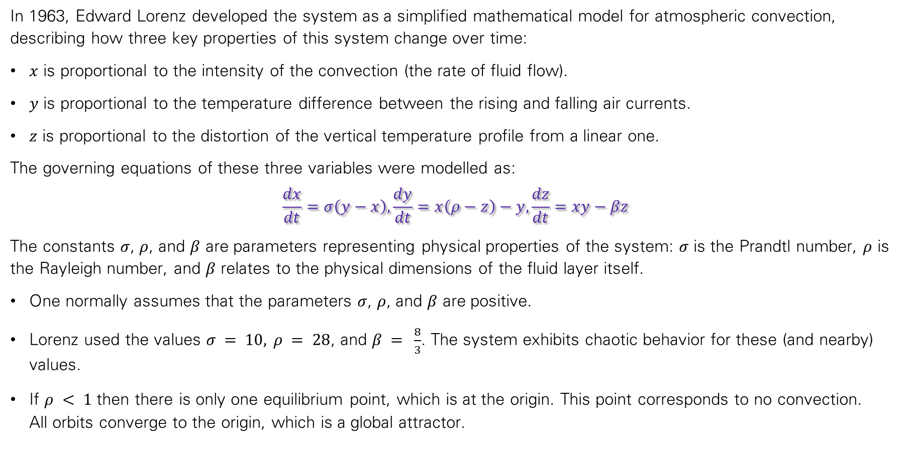
Lorenz System
In 1963, Edward Lorenz developed the system as a simplified mathematical model for atmospheric convection, describing how three key properties of this system change over time:
$x$ is proportional to the intensity of the convection (the rate of fluid flow).
$y$ is proportional to the temperature difference between the rising and falling air currents.
$z$ is proportional to the distortion of the vertical temperature profile from a linear one.
The governing equations of these three variables were modelled as:
$$\frac{dx}{dt}=σ\left(y−x\right),\frac{dy}{dt}=x\left(ρ−z\right)−y,\frac{dz}{dt}=xy−βz$$
The constants $σ$, $ρ$, and $β$ are parameters representing physical properties of the system: $σ$ is the Prandtl number, $ρ$ is the Rayleigh number, and $β$ relates to the physical dimensions of the fluid layer itself.
One normally assumes that the parameters $σ$, $ρ$, and $β$ are positive.
Lorenz used the values $σ = 10, ρ = 28$, and $β = ⁠\frac{8}{3}$. The system exhibits chaotic behavior for these (and nearby) values.
If $ρ < 1$ then there is only one equilibrium point, which is at the origin. This point corresponds to no convection. All orbits converge to the origin, which is a global attractor.

Slide 32
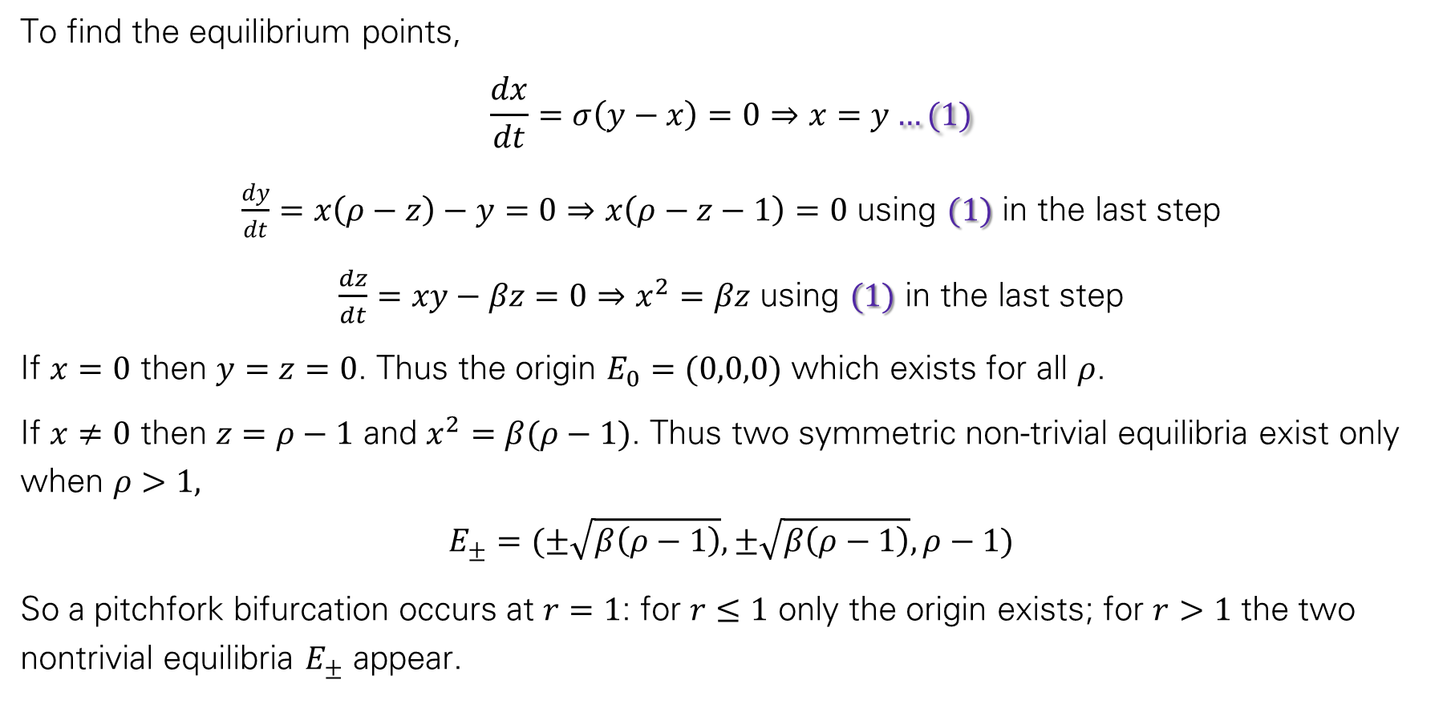
Solution of Lorenz System
To find the equilibrium points,
$$\frac{dx}{dt}=σ\left(y−x\right)=0⇒x=y…(1)$$
$\frac{dy}{dt}=x\left(ρ−z\right)−y=0⇒x\left(ρ−z−1\right)=0$ using $(1)$ in the last step
$\frac{dz}{dt}=xy−βz=0⇒x^{2}=βz$ using $(1)$ in the last step
If $x=0$ then $y=z=0$. Thus the origin $E_{0}=(0,0,0)$ which exists for all $ρ$.
If $x≠0$ then $z=ρ−1$ and $x^{2}=β(ρ−1)$. Thus two symmetric non-trivial equilibria exist only when $ρ>1,$
$$E_{±}=(±\sqrt{β\left(ρ−1\right)}, ±\sqrt{β\left(ρ−1\right)},ρ−1)$$
So a pitchfork bifurcation occurs at $r=1$: for $r≤1$ only the origin exists; for $r>1$ the two nontrivial equilibria $E_{±}$​ appear.

Slide 33
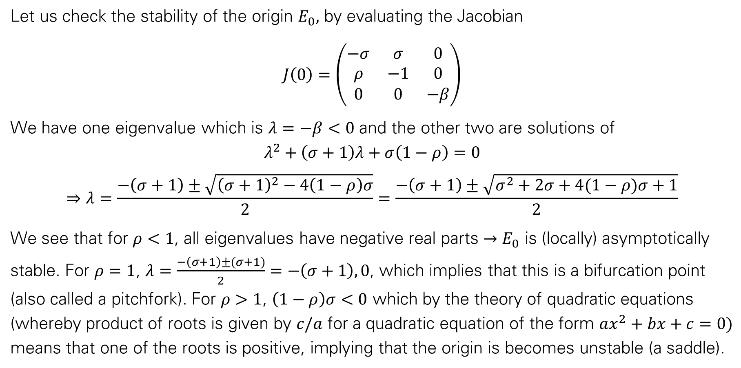
Solution of Lorenz System
Let us check the stability of the origin $E_{0},$ by evaluating the Jacobian
$$J\left(0\right)=\left(\begin{matrix}−σ & σ & 0 \\ ρ & −1 & 0 \\ 0 & 0 & −β\end{matrix}\right)$$
We have one eigenvalue which is $λ=−β<0$ and the other two are solutions of
$$λ^{2}+\left(σ+1\right)λ+σ\left(1−ρ\right)=0$$
$$⇒λ=\frac{−\left(σ+1\right)±\sqrt{{\left(σ+1\right)}^{2}−4\left(1−ρ\right)σ}}{2}=\frac{−\left(σ+1\right)±\sqrt{σ^{2}+2σ+4(1−ρ)σ+1}}{2}$$
We see that for $ρ<1$, all eigenvalues have negative real parts $→E_{0}$ is (locally) asymptotically stable. For $ρ=1$, $λ=\frac{−\left(σ+1\right)±(σ+1)}{2}=−\left(σ+1\right), 0$, which implies that this is a bifurcation point (also called a pitchfork). For $ρ>1$, $\left(1−ρ\right)σ<0$ which by the theory of quadratic equations (whereby product of roots is given by $c/a$ for a quadratic equation of the form $ax^{2}+bx+c=0)$ means that one of the roots is positive, implying that the origin is becomes unstable (a saddle).

Slide 34
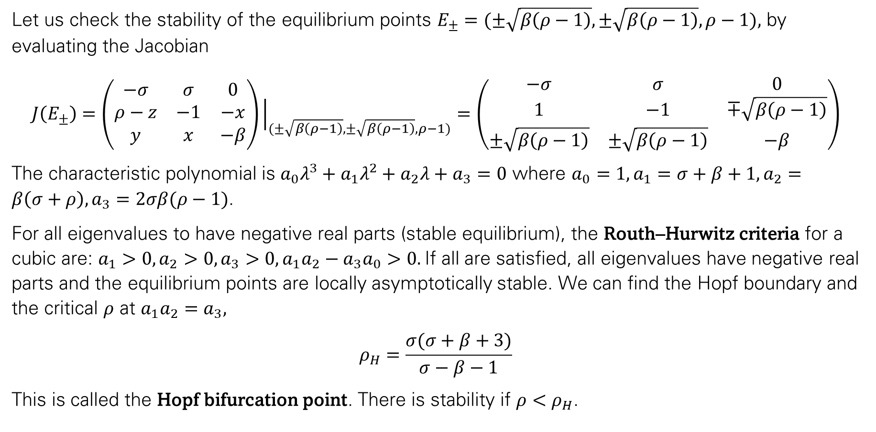
Solution of Lorenz System
Let us check the stability of the equilibrium points $E_{±}=(±\sqrt{β\left(ρ−1\right)}, ±\sqrt{β\left(ρ−1\right)},ρ−1),$ by evaluating the Jacobian
$$J\left(E_{±}\right)=\left(\begin{matrix}−σ & σ & 0 \\ ρ−z & −1 & −x \\ y & x & −β\end{matrix}\right){\left.​\right|}_{(±\sqrt{β\left(ρ−1\right)}, ±\sqrt{β\left(ρ−1\right)},ρ−1)}=\left(\begin{matrix}−σ & σ & 0 \\ 1 & −1 & ∓\sqrt{β\left(ρ−1\right)} \\ ±\sqrt{β\left(ρ−1\right)} & ±\sqrt{β\left(ρ−1\right)} & −β\end{matrix}\right)$$
The characteristic polynomial is $a_{0}λ^{3}+a_{1}λ^{2}+a_{2}λ+a_{3}=0$ where ${a_{0}=1,a}_{1}=σ+β+1, a_{2}=β\left(σ+ρ\right), a_{3}=2σβ(ρ−1)$.
For all eigenvalues to have negative real parts (stable equilibrium), the Routh–Hurwitz criteria for a cubic are: $a_{1}>0, a_{2}>0,a_{3}>0, a_{1}a_{2}−a_{3}a_{0}>0.$If all are satisfied, all eigenvalues have negative real parts and the equilibrium points are locally asymptotically stable. We can find the Hopf boundary and the critical $ρ$ at $a_{1}a_{2}=a_{3},$
$$ρ_{H}=\frac{σ(σ+β+3)}{σ−β−1}$$
This is called the Hopf bifurcation point. There is stability if $ρ<ρ_{H}$.

Slide 35
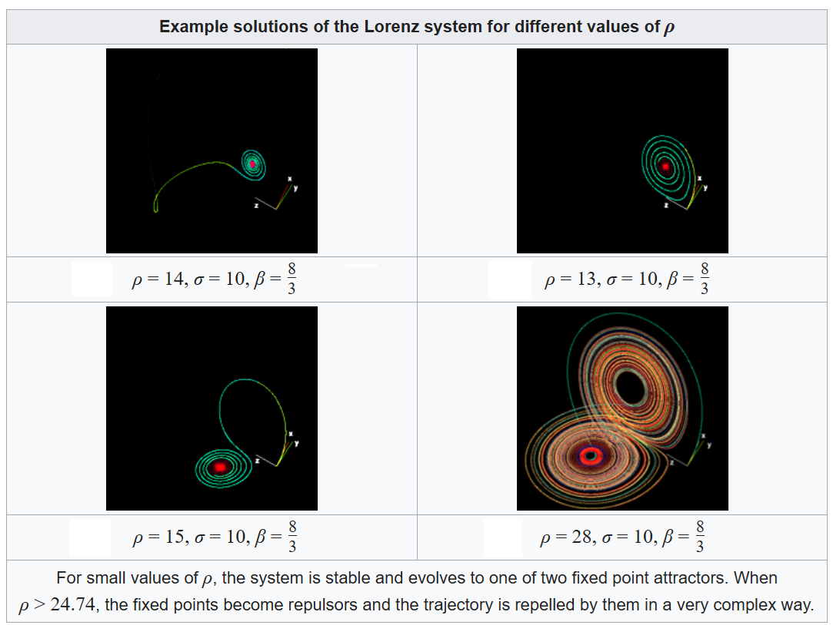

Slide 36
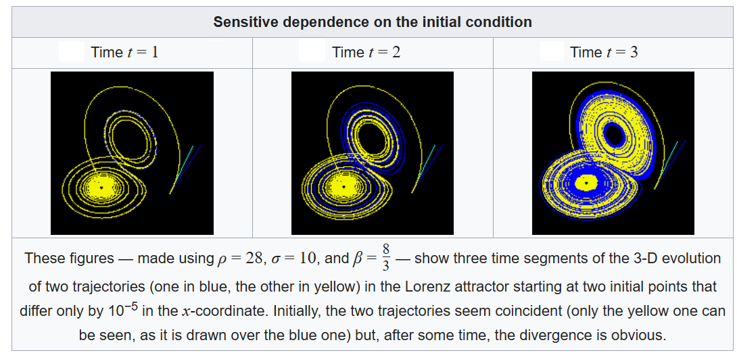

Slide 37
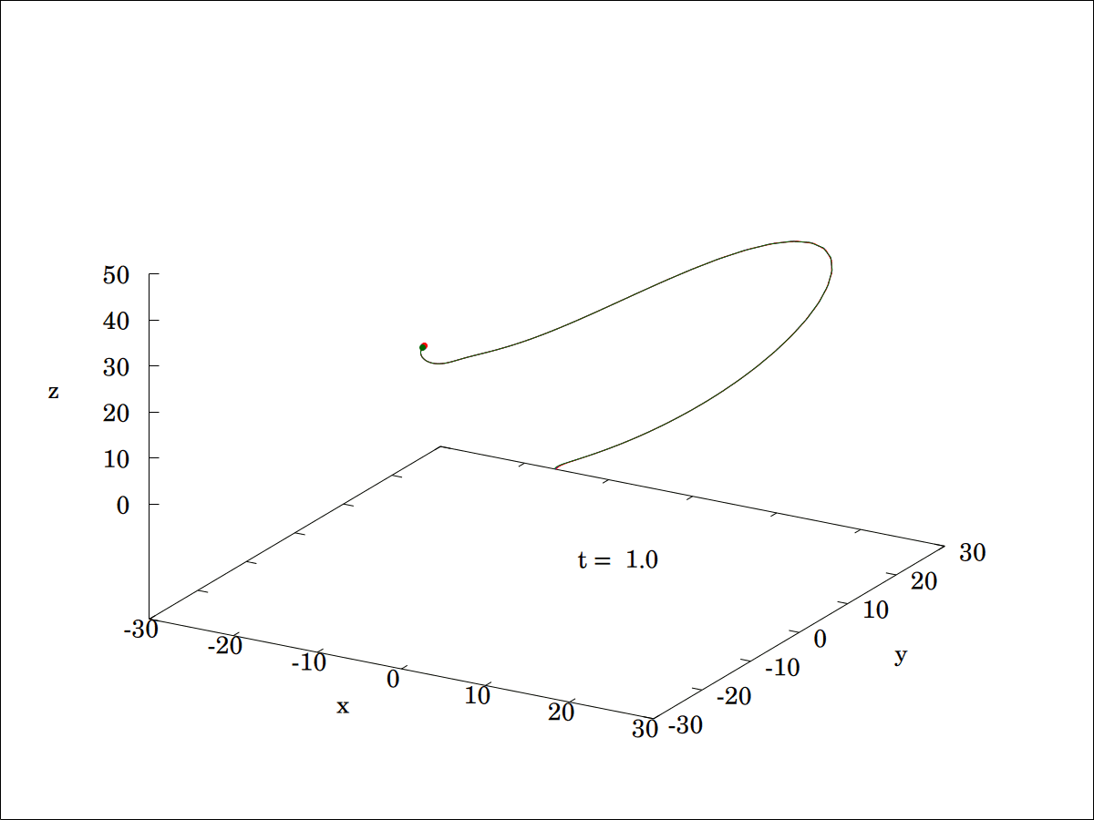
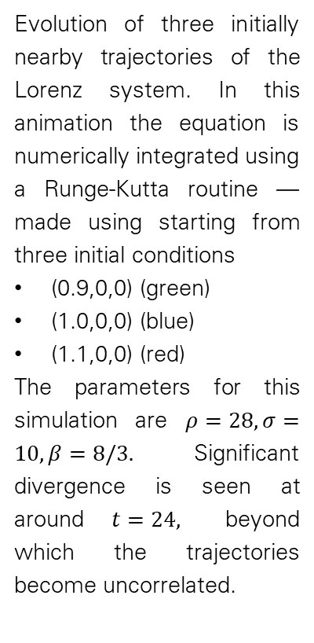
Evolution of three initially nearby trajectories of the Lorenz system. In this animation the equation is numerically integrated using a Runge-Kutta routine — made using starting from three initial conditions
(0.9,0,0) (green)
(1.0,0,0) (blue)
(1.1,0,0) (red)
The parameters for this simulation are $ρ=28, σ=10, β=8/3.$ Significant divergence is seen at around $t=24,$ beyond which the trajectories become uncorrelated.

Slide 38
Nonlinear Dynamics and Chaos (Lorenz System)
%% Lorenz System Simulation
clc; clear; close all;
% Parameters
sigma = 10;
rho = 28;
beta = 8/3;
% Time settings
tspan = [0 50];
dt = 0.01;
t = tspan(1):dt:tspan(2);
% Initial conditions
x0_1 = [1; 1; 1]; % First initial condition
x0_2 = [1.001; 1; 1]; % Slightly perturbed initial condition
%% Lorenz system as a function
lorenz = @(t,x) [ sigma*(x(2)-x(1));
x(1)*(rho - x(3)) - x(2);
x(1)*x(2) - beta*x(3)];
%% Numerical integration using ode45
[~,X1] = ode45(lorenz, t, x0_1);
[~,X2] = ode45(lorenz, t, x0_2);
%% Plot 3D phase portrait (butterfly attractor)
figure('Name','Lorenz Butterfly Attractor','NumberTitle','off');
plot3(X1(:,1), X1(:,2), X1(:,3), 'b', 'LineWidth', 1.5); hold on;
plot3(X2(:,1), X2(:,2), X2(:,3), 'r', 'LineWidth', 1.5);
xlabel('x'); ylabel('y'); zlabel('z');
title('Lorenz System - Butterfly Attractor');
legend('IC1','IC2 (perturbed)');
grid on; view(45,30);
%% Plot divergence of nearby trajectories
figure('Name','Sensitive Dependence','NumberTitle','off');
plot(t, sqrt(sum((X1 - X2).^2,2)), 'LineWidth', 1.5);
xlabel('Time'); ylabel('Distance between trajectories');
title('Sensitive Dependence on Initial Conditions');
grid on;
%% 2D Phase Portraits
figure('Name','2D Phase Portraits','NumberTitle','off');
subplot(1,2,1);
plot(X1(:,1), X1(:,2), 'b'); hold on;
plot(X2(:,1), X2(:,2), 'r'); xlabel('x'); ylabel('y');
title('x-y Phase Portrait'); grid on;
subplot(1,2,2);
plot(X1(:,1), X1(:,3), 'b'); hold on;
plot(X2(:,1), X2(:,3), 'r'); xlabel('x'); ylabel('z');
title('x-z Phase Portrait'); grid on;

Slide 39
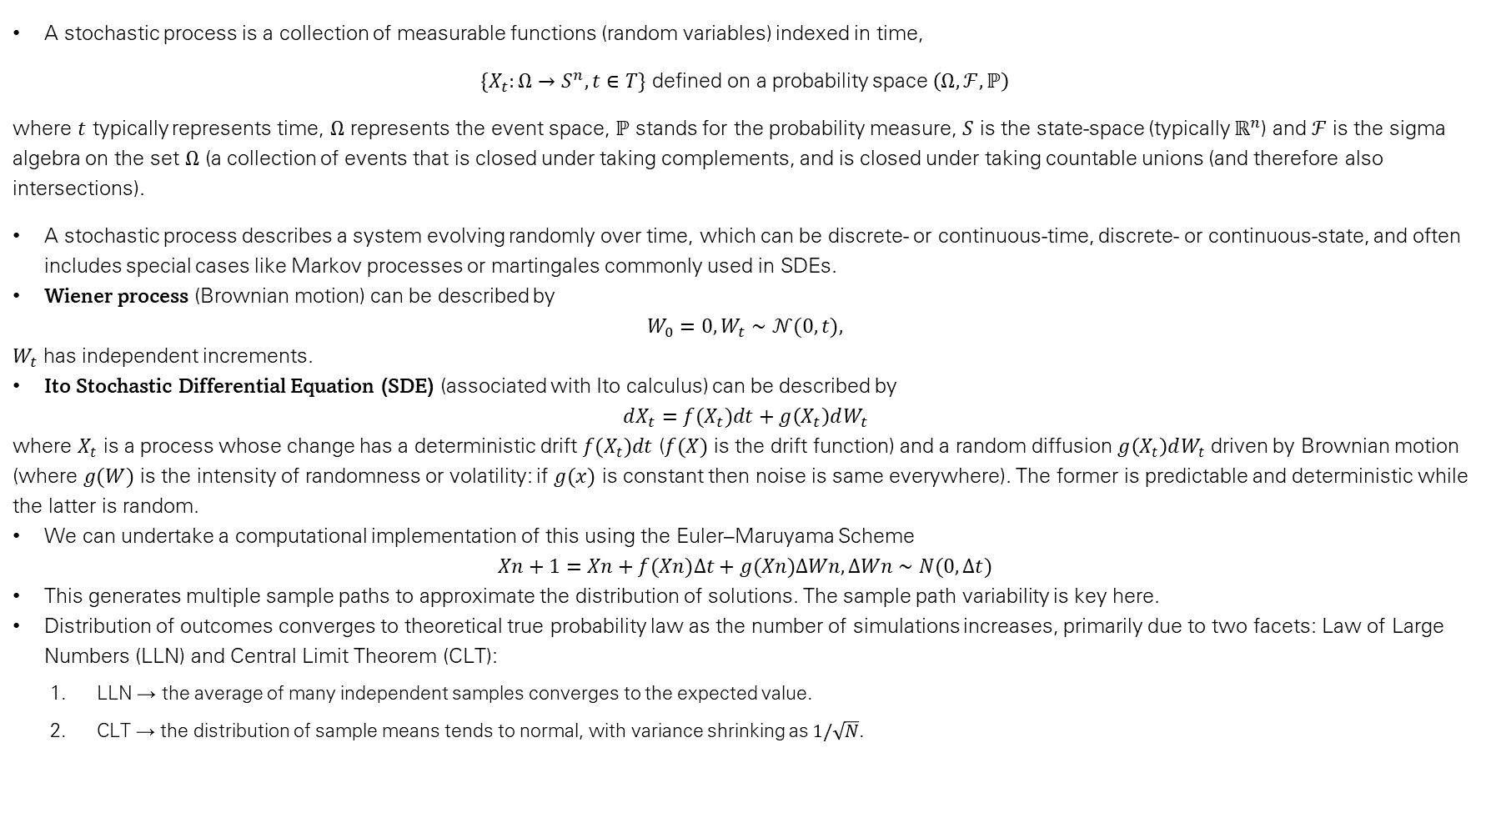
Stochastic Models
A stochastic process is a collection of measurable functions (random variables) indexed in time,
$\{X_{t}:Ω→S^{n}, t∈T\}$ defined on a probability space $\left(Ω,ℱ,ℙ\right)$
where $t$ typically represents time, $Ω$ represents the event space, $ℙ$ stands for the probability measure, $S$ is the state-space (typically $ℝ^{n}$) and $ℱ$ is the sigma algebra on the set $Ω$ (a collection of events that is closed under taking complements, and is closed under taking countable unions (and therefore also intersections).
A stochastic process describes a system evolving randomly over time, which can be discrete- or continuous-time, discrete- or continuous-state, and often includes special cases like Markov processes or martingales commonly used in SDEs.
Wiener process (Brownian motion) can be described by
$$W_{0}=0,W_{t}∼𝒩(0,t),$$
$W_{t}$ has independent increments.
Ito Stochastic Differential Equation (SDE) (associated with Ito calculus) can be described by
$$dX_{t}=f(X_{t})dt+g\left(X_{t}\right)dW_{t}$$
where $X_{t}$​ is a process whose change has a deterministic drift $f(X_{t})dt$ ($f(X)$ is the drift function) and a random diffusion $g\left(X_{t}\right)dW_{t}​$ driven by Brownian motion (where $g(W)$ is the intensity of randomness or volatility: if $g(x)$ is constant then noise is same everywhere). The former is predictable and deterministic while the latter is random.
We can undertake a computational implementation of this using the Euler–Maruyama Scheme
$$Xn+1=Xn+f(Xn)Δt+g(Xn)ΔWn,ΔWn∼N(0,Δt)$$
This generates multiple sample paths to approximate the distribution of solutions. The sample path variability is key here.
Distribution of outcomes converges to theoretical true probability law as the number of simulations increases, primarily due to two facets: Law of Large Numbers (LLN) and Central Limit Theorem (CLT):
  LLN → the average of many independent samples converges to the expected value.
  CLT → the distribution of sample means tends to normal, with variance shrinking as $1/\sqrt{N}$​.

Slide 40
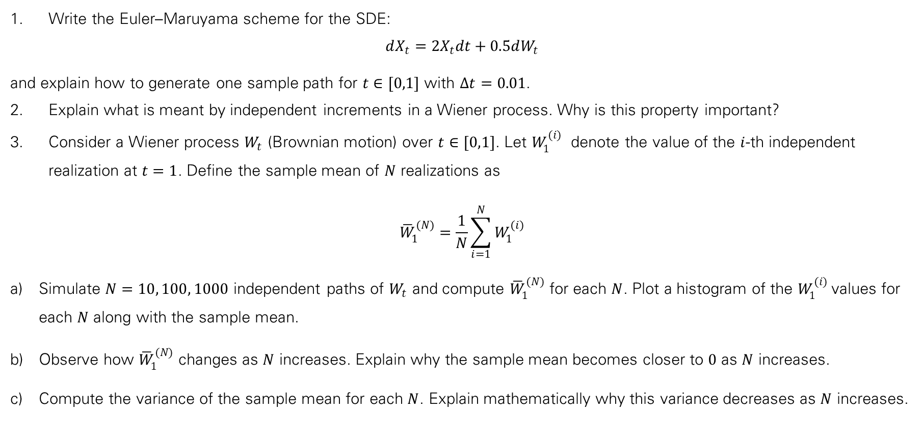
Exercise
Write the Euler–Maruyama scheme for the SDE:
$$dX_{t}=2X_{t}dt+0.5dW_{t}$$
and explain how to generate one sample path for $t∈[0,1]$ with $Δt=0.01$.
Explain what is meant by independent increments in a Wiener process. Why is this property important?
Consider a Wiener process $W_{t}$ (Brownian motion) over $t∈[0,1]$. Let $W_{1}^{(i)}$ ​ denote the value of the $i$-th independent realization at $t=1$. Define the sample mean of $N$ realizations as
$${\overline{W}}_{1}^{(N)}=\frac{1}{N}\sum_{i=1}^{N}{W_{1}^{(i)}}$$
Simulate $N=10, 100, 1000$ independent paths of $W_{t}$​ and compute ${\overline{W}}_{1}^{(N)}$​ for each $N$. Plot a histogram of the $W_{1}^{(i)}$values for each $N$ along with the sample mean.
Observe how ${\overline{W}}_{1}^{(N)}$​ changes as $N$ increases. Explain why the sample mean becomes closer to $0$ as $N$ increases.
Compute the variance of the sample mean for each $N$. Explain mathematically why this variance decreases as $N$ increases.

Slide 41
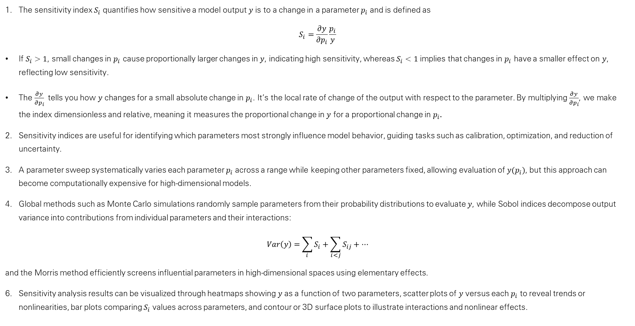
Parameter Sensitivity and Uncertainty
The sensitivity index $S_{i}$​ quantifies how sensitive a model output $y$ is to a change in a parameter $p_{i}$​ and is defined as
$$S_{i}=\frac{∂y}{∂p_{i}}\frac{p_{i}}{y}$$
If $S_{i}>1$, small changes in $p_{i}$​ cause proportionally larger changes in $y$, indicating high sensitivity, whereas $S_{i}<1$ implies that changes in $p_{i}$​ have a smaller effect on $y$, reflecting low sensitivity.
The $\frac{∂y}{∂p_{i}}$ tells you how $y$ changes for a small absolute change in $p_{i}$​. It’s the local rate of change of the output with respect to the parameter. By multiplying $\frac{∂y}{∂p_{i}}$​, we make the index dimensionless and relative, meaning it measures the proportional change in $y$ for a proportional change in $p_{i}.$​
Sensitivity indices are useful for identifying which parameters most strongly influence model behavior, guiding tasks such as calibration, optimization, and reduction of uncertainty.
A parameter sweep systematically varies each parameter $p_{i}$​ across a range while keeping other parameters fixed, allowing evaluation of $y(p_{i})$, but this approach can become computationally expensive for high-dimensional models.
Global methods such as Monte Carlo simulations randomly sample parameters from their probability distributions to evaluate $y$, while Sobol indices decompose output variance into contributions from individual parameters and their interactions:
$$Var\left(y\right)=\sum_{i}{S_{i}}+\sum_{i<j}{S_{ij}}+…$$
and the Morris method efficiently screens influential parameters in high-dimensional spaces using elementary effects.
Sensitivity analysis results can be visualized through heatmaps showing $y$ as a function of two parameters, scatter plots of $y$ versus each $p_{i}$ to reveal trends or nonlinearities, bar plots comparing $S_{i}$​ values across parameters, and contour or 3D surface plots to illustrate interactions and nonlinear effects.

Slide 42
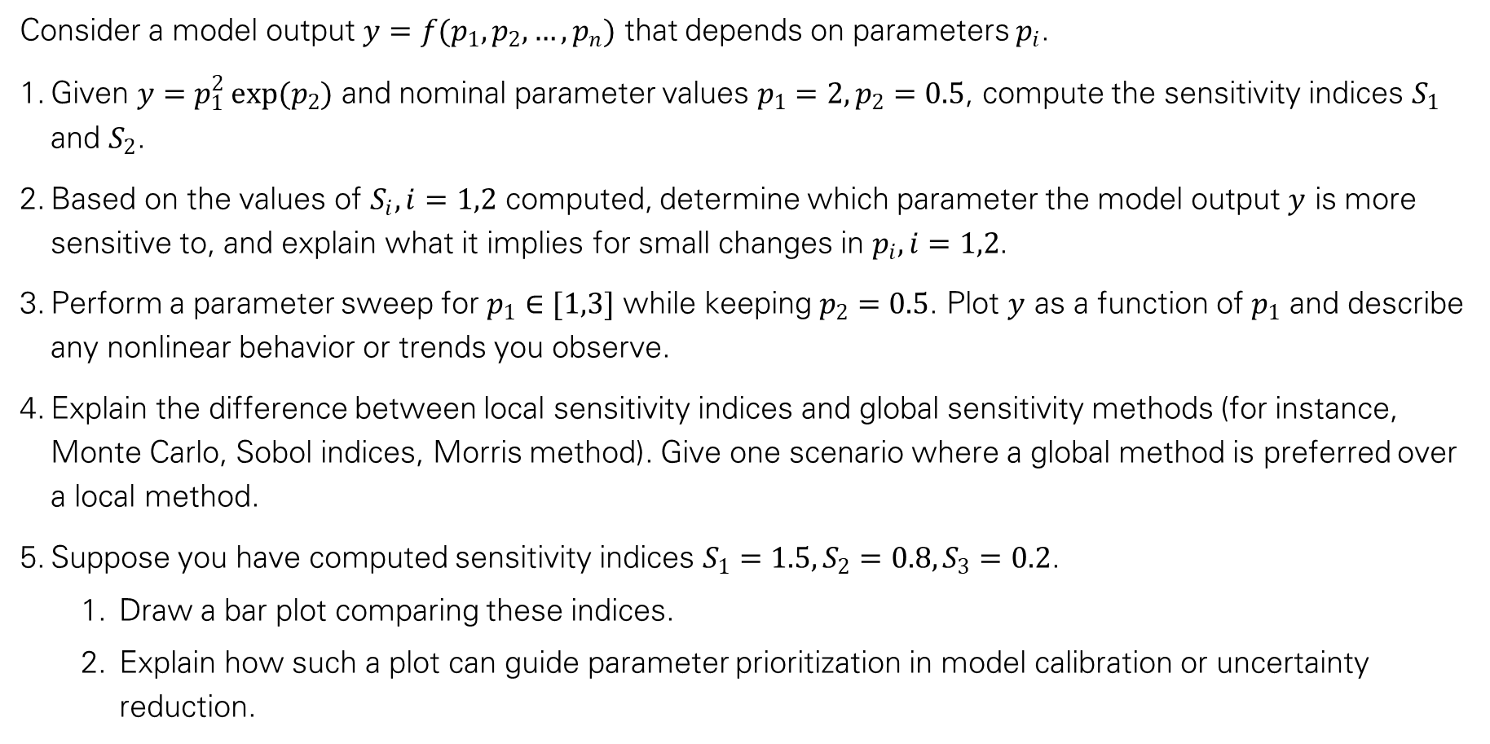
Exercise
Consider a model output $y=f(p_{1},p_{2},…,p_{n})$ that depends on parameters $p_{i}$​.
Given $y=p_{1}^{2} exp(p_{2})$ and nominal parameter values $p_{1}=2, p_{2}=0.5$, compute the sensitivity indices $S_{1}$​ and $S_{2}$​.
Based on the values of $S_{i}, i=1,2$​ computed, determine which parameter the model output $y$ is more sensitive to, and explain what it implies for small changes in $p_{i}, i=1,2$​.
Perform a parameter sweep for $p_{1}∈[1,3]$ while keeping $p_{2}=0.5$. Plot $y$ as a function of $p_{1}​$ and describe any nonlinear behavior or trends you observe.
Explain the difference between local sensitivity indices and global sensitivity methods (for instance, Monte Carlo, Sobol indices, Morris method). Give one scenario where a global method is preferred over a local method.
Suppose you have computed sensitivity indices $S_{1}=1.5, S_{2}=0.8,S_{3}=0.2$.
  Draw a bar plot comparing these indices.
  Explain how such a plot can guide parameter prioritization in model calibration or uncertainty reduction.

Slide 43
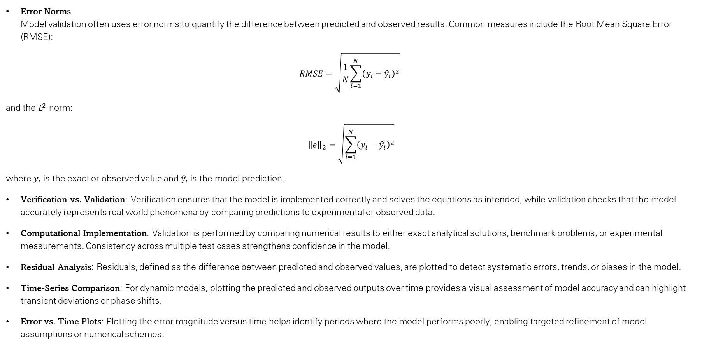
Model Validation and Analysis
Error Norms:
Model validation often uses error norms to quantify the difference between predicted and observed results. Common measures include the Root Mean Square Error (RMSE):
$$RMSE=\sqrt{\frac{1}{N}\sum_{i=1}^{N}{{\left(y_{i}−{\hat{y}}_{i}\right)}^{2}}}​$$
and the $L^{2}$ norm:
$${\left\|e\right\|}_{2}=\sqrt{\sum_{i=1}^{N}{{\left(y_{i}−{\hat{y}}_{i}\right)}^{2}}}$$
where$y_{i}$ is the exact or observed value and ${\hat{y}}_{i}$​is the model prediction.
Verification vs. Validation: Verification ensures that the model is implemented correctly and solves the equations as intended, while validation checks that the model accurately represents real-world phenomena by comparing predictions to experimental or observed data.
Computational Implementation: Validation is performed by comparing numerical results to either exact analytical solutions, benchmark problems, or experimental measurements. Consistency across multiple test cases strengthens confidence in the model.
Residual Analysis: Residuals, defined as the difference between predicted and observed values​, are plotted to detect systematic errors, trends, or biases in the model.
Time-Series Comparison: For dynamic models, plotting the predicted and observed outputs over time provides a visual assessment of model accuracy and can highlight transient deviations or phase shifts.
Error vs. Time Plots: Plotting the error magnitude versus time helps identify periods where the model performs poorly, enabling targeted refinement of model assumptions or numerical schemes.

Slide 44
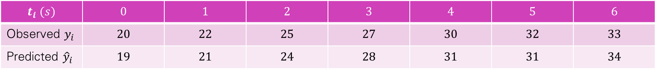
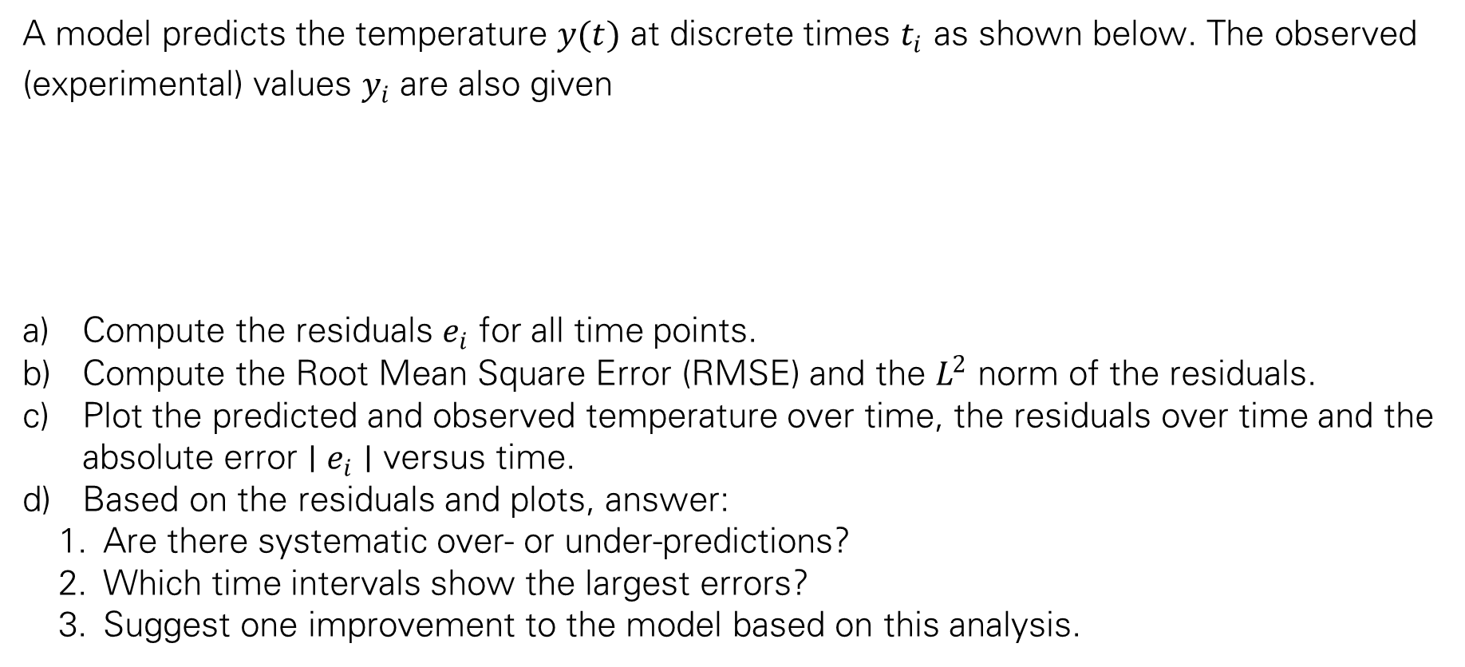
Exercise
A model predicts the temperature $y(t)$ at discrete times $t_{i}$​ as shown below. The observed (experimental) values $y_{i}$​ are also given
Compute the residuals $e_{i}$ for all time points.
Compute the Root Mean Square Error (RMSE) and the $L^{2}$ norm of the residuals.
Plot the predicted and observed temperature over time, the residuals​ over time and the absolute error $∣e_{i}∣$ versus time.
Based on the residuals and plots, answer:
  Are there systematic over- or under-predictions?
  Which time intervals show the largest errors?
  Suggest one improvement to the model based on this analysis.
$$t_{i} (s)$$ | $$0$$ | $$1$$ | $$2$$ | $$3$$ | $$4$$ | $$5$$ | $$6$$
Observed $y_{i}$ | $$20$$ | $$22$$ | $$25$$ | $$27$$ | $$30$$ | $$32$$ | $$33$$
Predicted ${\hat{y}}_{i}$ | $$19$$ | $$21$$ | $$24$$ | $$28$$ | $$31$$ | $$31$$ | $$34$$

Slide 45
Exercise
How can you simulate the Lotka–Volterra predator-prey equations in MATLAB to plot predator and prey populations over time?
How can you model a spring-mass-damper system in MATLAB with both linear and nonlinear damping and compare their displacement and velocity responses?
How can you implement the Black–Scholes PDE in MATLAB to calculate and plot European call and put option prices for varying strike prices and maturities?
How can you simulate traffic flow on a single-lane highway in MATLAB to study the impact of vehicle density on congestion formation over time?

